Slide 1
Writing an impactful
policy brief
Dr. Kathryn Toure, IDRC
7 December 2022 workshop
with Fellows of the
African Leadership Centre,
Nairobi Kenya
Notes:
cover image from: https://ecosocc.au.int/en/yawc22

Slide 2
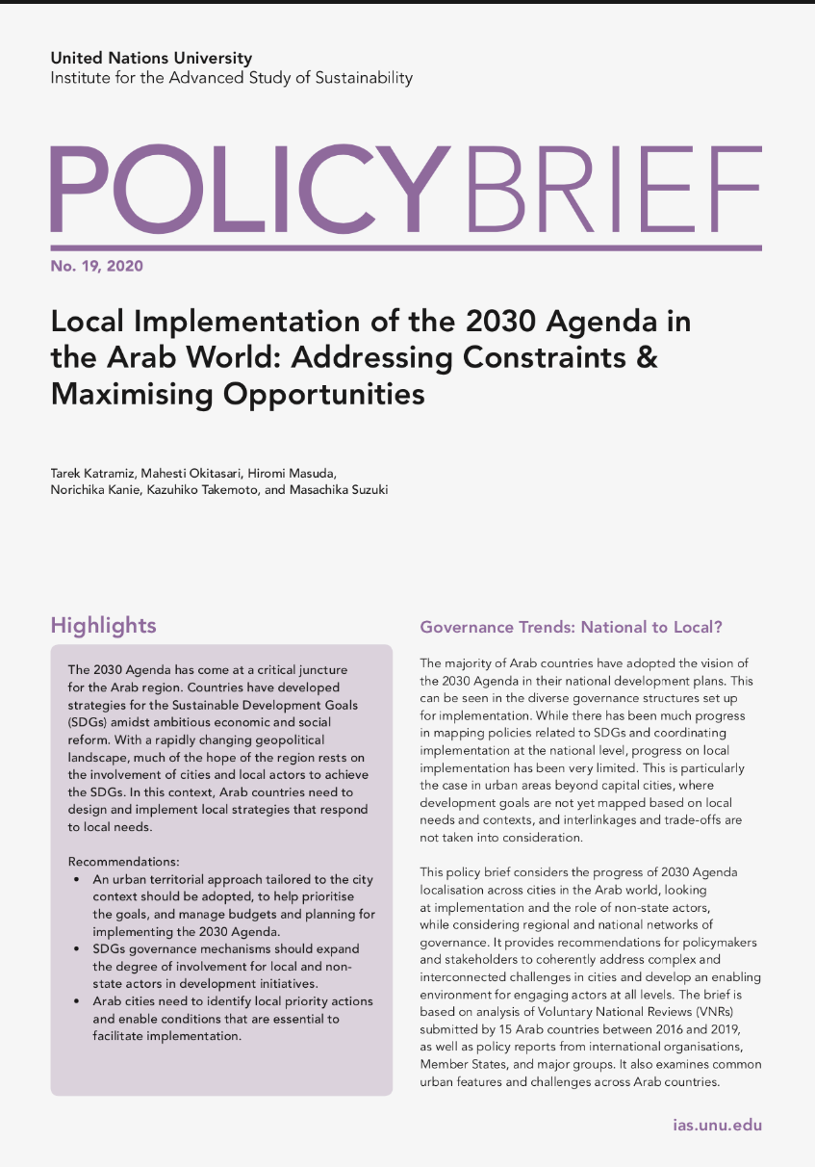
What is a policy brief?
Notes:
(see answers in last slide)

Slide 3
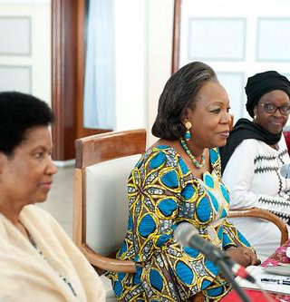
What is a policy brief?
Succinctly written and easy to read document
Based on evidence / research
Provides guidance to policymakers
Proposes practical actions
Notes:
UN Women Executive Director Visits Central African Republic
UN Women Executive Director Phumzile Mlambo-Ngcuka and Special Representative of the African Union for Women, Peace and Security Bineta Diop meet with President of the Central African Republic Catherine Samba-Panza in Bangui, Central African Republic, on 26 May 2014. Photo: UN Women/Catianne Tijerina
UN Women Executive Director Visits Central African Republi… | Flickr

Slide 4
What to consider in writing a policy brief?

Slide 5
What to consider in writing a policy brief?
Research the issue
Know your audience
Determine the recommended policy options / actions

Slide 6
What to include in a policy brief?

Slide 7
What to include in a policy brief?
Title
Summary
Brief description of the context / problem
Findings / evidence
Realistic policy recommendations

Slide 8
A “not-so-good” policy brief (summary)
Adolescents’ Dermatologic Health in Outlandia: A Call to Action
The Report on Adolescents’ Dermatologic Health in Outlandia (2010), issued by Secretary of Health Dr. Polly Galver, served as a platform to increase public awareness on the importance of dermatologic health for adolescents. Among the major themes of the report are that dermatologic health is essential to general health and well-being and that profound and consequential dermatologic health disparities exist in the state of Outlandia. Dr. Galver stated that what amounts to a silent epidemic of acne is affecting some population groups–restricting activities as schools, work, and home–and often significantly diminishing the quality of life. Dr. Galver issued the Report on Adolescents’ Dermatologic Health as a wake-up call to policymakers and health professionals on issues regarding the state’s dermatologic health.
Notes:
(see answers in last slide)

Slide 9
Why was that a “not-so-good” policy brief (summary)?
The paragraph introduces a relevant and credible source, but it fails to use that source to explain a problem and propose policy action. The reader is likely to be confused because the word “acne” does not appear until the middle of the paragraph, and the brief never states what action should be taken to address it. In addition to this lack of focus, the paragraph also includes unnecessary phrases like “among the major themes” that could be removed to make it more concise.
Source: Policy Briefs – The Writing Center • University of North Carolina at Chapel Hill (unc.edu)
Notes:
(see answers in last slide)

Slide 10
A better policy brief (summary)
Seeing Spots: Addressing the Silent Epidemic of Acne in Outlandia’s Youth
Acne is the most common chronic disease among adolescents in Outlandia (Outlandia Department of Health, 2010). Long considered a benign rite of passage, acne actually has far-reaching effects on the health and well being of adolescents, significantly affecting success in school, social relationships, and general quality of life. Yet large portions of the state’s population are unable to access treatment for acne. The Secretary of Health’s Report on Adolescents’ Dermatologic Health in Outlandia (2010) is a call to action for policymakers and health professionals to improve the health and wellbeing of Outlandia’s youth by increasing access to dermatologic care (“A Better Policy Brief”, Reproduced with permission of the Johns Hopkins Bloomberg School of Public Health, Baltimore, MD.)
Notes:
(see answers in last slide)

Slide 11
Why was that a better policy brief (summary)?
The paragraph is far more focused and concise than the first version. The opening sentence is straightforward; instead of focusing on the source, it makes a clear and memorable point that is supported by the source. Additionally, though the first version was titled “a call to action,” it did not actually say what that action might be. In this version, it is clear that the call is for increased access to dermatologic care.
Keep in mind that clarity, conciseness, and consistent focus are rarely easy to achieve in a first draft. Careful editing and revision are key parts of writing policy briefs.
Source: Policy Briefs – The Writing Center • University of North Carolina at Chapel Hill (unc.edu)
Notes:
(see answers in last slide)

Slide 12
Taking a look at a policy brief
See UNU-IAS-PB-No22-2021.pdf on Building Resilience (2021)
From: UNU-IAS Policy Brief Series - Institute for the Advanced Study of Sustainability

Slide 13
Tips for writing a policy brief

Slide 14
Tips for
writing a
policy brief
Get to the point
Be clear
No jargon
Be realistic
State recommendations clearly, place them strategically

Slide 15
Questions? Comments?

Slide 16
References
https://writingcenter.unc.edu/tips-and-tools/policy-briefs with an example of a “not-so-good” policy brief and “a better policy brief”
www.researchtoaction.org/2022/11/top-tips-for-writing-impactful-policy-briefs

Slide 17
Examples of policy briefs
Benefits of subsidized childcare in Kenya (4 pages)
https://idl-bnc-idrc.dspacedirect.org/bitstream/handle/10625/56973/IDL-56973.pdf?sequence=2&isAllowed=y
The case for investing in childcare (4 pages)
Recovering from COVID-19: The case for investing in childcare
Food systems and food security in the time of lockdowns: Insights from sub-Saharan Africa | IDRC - International Development Research Centre (5 pages)
https://includeplatform.net/publications/freedom-of-movement-unlocking-africas-development-potential (8 pages)
At COP27 in Egypt in November 2022, the African Group of Negotiators was actively (daily) making use of the “fact sheet” briefs produced through a collaboration between the Climate and Development Knowledge Network (CDKN) and African contributors to the Intergovernmental Panel on Climate Change (IPCC) Working Group (WG) 2 report, specifically the Africa Chapter. Because the briefs were so intensively used, we assume they must be good. The report on which the briefs (listed below) are based is the IPPC report titled Climate Change 2022: Impacts, Adaptation and Vulnerability.
East Arica brief: http://cdkn.org/ar6-eastafrica (20 pages, in English)
Southern Africa brief: http://cdkn.org/ar6-southernafrica (in English and Portuguese)
Central Africa brief: http://cdkn.org/ar6-centralafrica (in French and English)
West Africa brief: http://cdkn.org/ar6-westafrica (in French and English)
Policy briefs by the Partnership for Economic Policy (PEP), based in Nairobi and working globally
www.pep-net.org/publications/policy-briefs
Policy briefs of the United Nations University Institute for the Advanced Study of Sustainability
https://ias.unu.edu/en/publications/unu-ias-policy-brief-series
Notes:
(see answers in last slide)

