Slide 1
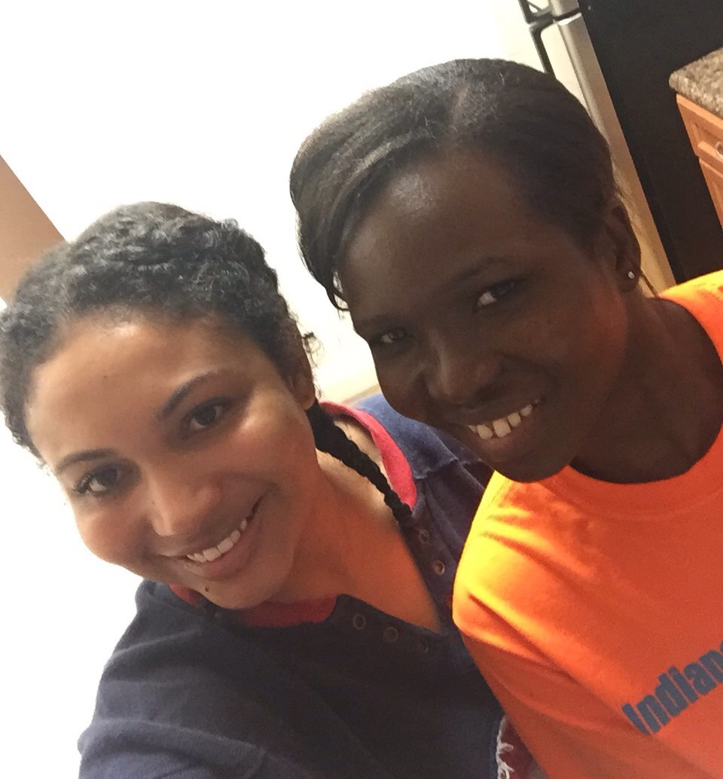

Non-Academic Writing:
Possibilities, Challenges, Fulfillment
Dr. Kathryn Toure
23 June 2020 workshop
with Fellows of the
African Leadership Centre,
Nairobi Kenya
Notes:
https://africanleadershipcentre.org/index.php/2014-10-22-15-41-35/2014-10-22-17-46-27/fellows-2019-2020

Slide 2


Fellows,
What would you like to gain from this session?
Notes:
Image = adinkra symbol for Leadership

Slide 3
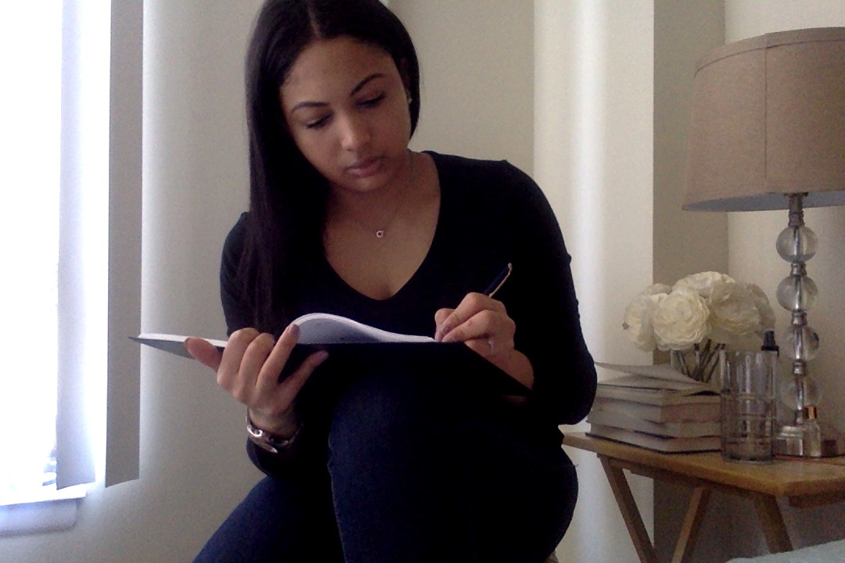
Why write for non-academic audiences?
Notes:
(see answers in last slide)

Slide 4
Why write?
What to write?
How to write?

Slide 5
1. Why write?

Slide 6
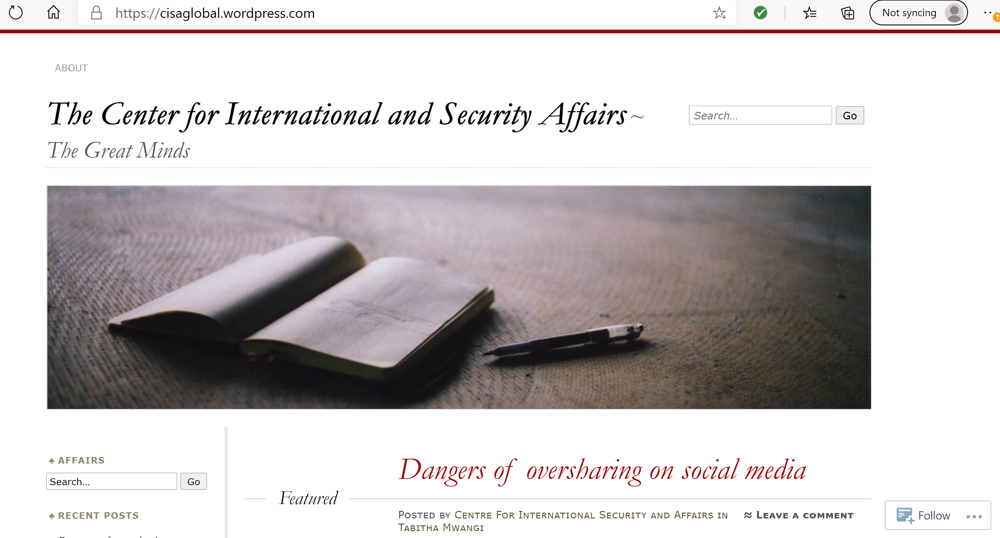
Notes:
Tabitha Mwangi, why did you write this? for whom?
Any reactions to it?
Any lesson from writing it?

Slide 7
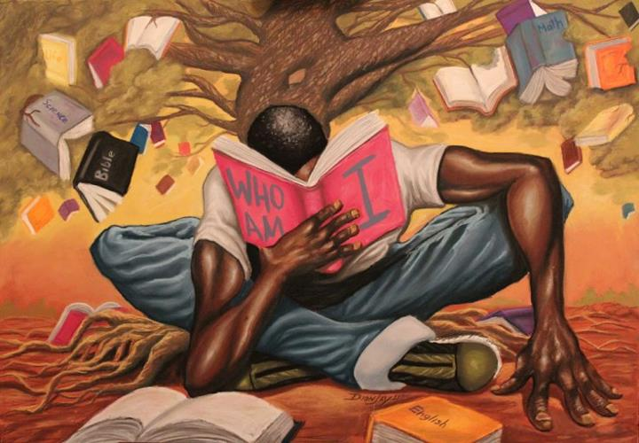
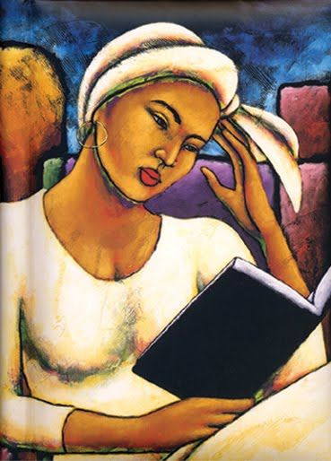
What book has had a lasting impact on you?

Slide 8
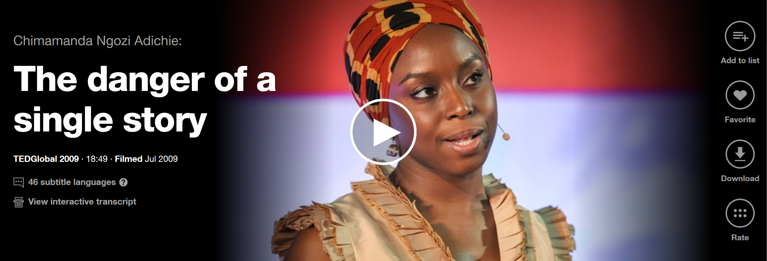
If we hear only a single story about a person, people, place or phenomenon, we risk a critical misunderstanding.
Adichie explains that
the discovery of African writers “saved me.”
video excerpt (17 sec)
Notes:
“Now, I loved those American and British books I read. They stirred my imagination. They opened up new worlds for me. But the unintended consequence was that I did not know that people like me could exist in literature. So what the discovery of African writers did for me was this: It saved me from having a single story of what books are.”
http://www.indiewire.com/2016/02/page-to-screen-possibilities-for-chimamanda-ngozi-adichies-americanah-lupita-nyongo-david-oyelowo-starring-156536
At its core, "Americanah“[Ngozi’s 3rd novel] is an expansive love story between
Ifemelu and Obinze, which also goes into careful
detail of his life as an undocumented immigrant in London as Ifemelu explores
her newfound American identity. Viewed as a place of opportunity and refuge
when they were kids, America becomes something very different to them as their
lives diverge.
So, how would the novel translate to the screen? With the
news that Lupita Nyong’o will be adapting the novel, with David Oyelowo co-starring,
one question is already off the table: Who would play Ifemelu?
I can’t think of an actress I’d want more in this role. Ifemelu inhabits a
brazen, unapologetic demeanor that is often absent from female characters in
film and literature. She is a feminist/activist for the digital age, calling
out things and people in her popular blog about race in America. This blog is
one of the many exciting areas of this novel, which both tracks the emergence
of blogging in pop culture, and serves as a sounding board for Ifemelu.

Slide 9

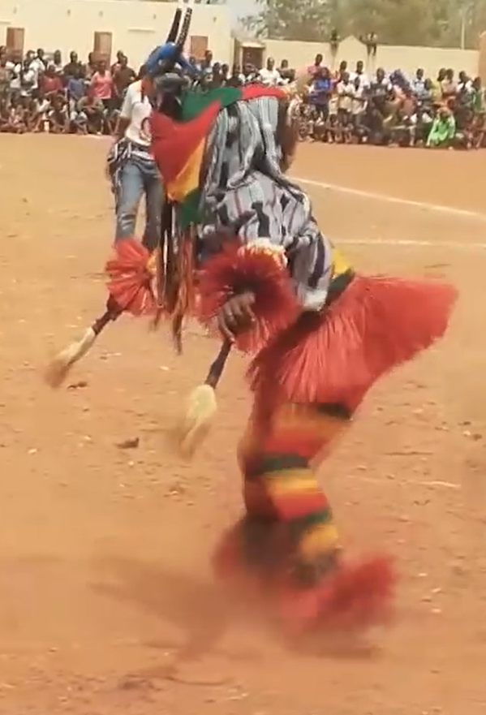
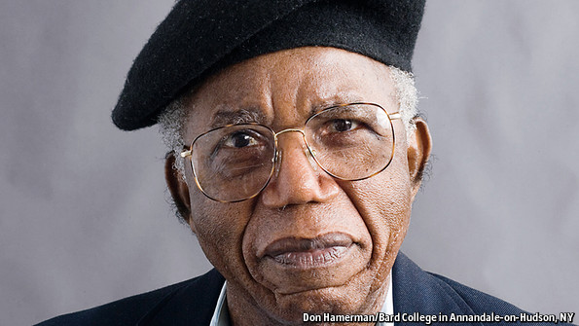
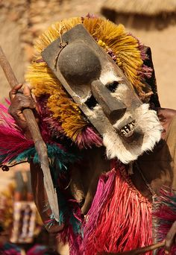
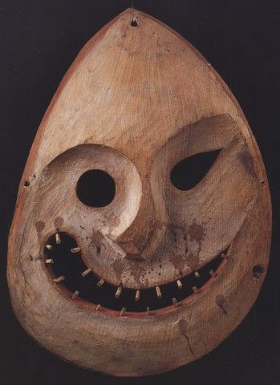
“The world is like a Mask dancing. If you want to see it well, you do not stand in one place.”
― Chinua Achebe
“The world is like a Mask dancing. If you want to see it well, you do not stand in one place.”
― Chinua Achebe
“The world is like a Mask dancing. If you want to see it well, you do not stand in one place.” ― Chinua Achebe
Until the lions have their own historians, the history of the hunt will always glorify the hunter.
Notes:
http://www.economist.com/news/obituary/21574453-chinua-achebe-africas-greatest-storyteller-died-march-21st-aged-82-chinua-achebe
Mr. Achebe was widely hailed as the father of African literature; but, smiling over his heavy bifocals, he rejected that. Instead, he repeated his favourite proverb: “Until the lions have their own historians, the history of the hunt will always glorify the hunter.” Small though he was, he turned out to be the African lions’ earliest and most important historian.

Slide 10
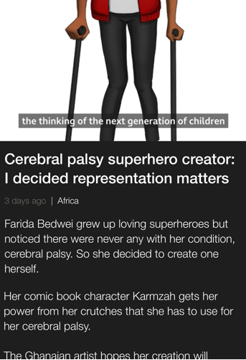

I decided representation matters.
Farida Bedwei

Slide 11
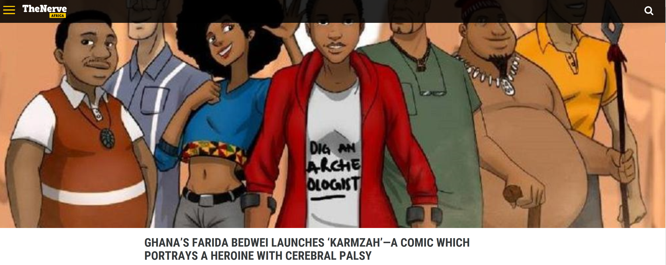

Slide 12
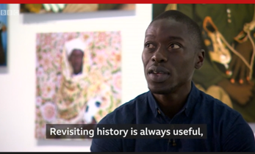
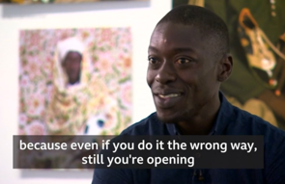
Omar Victor Diop

Slide 13
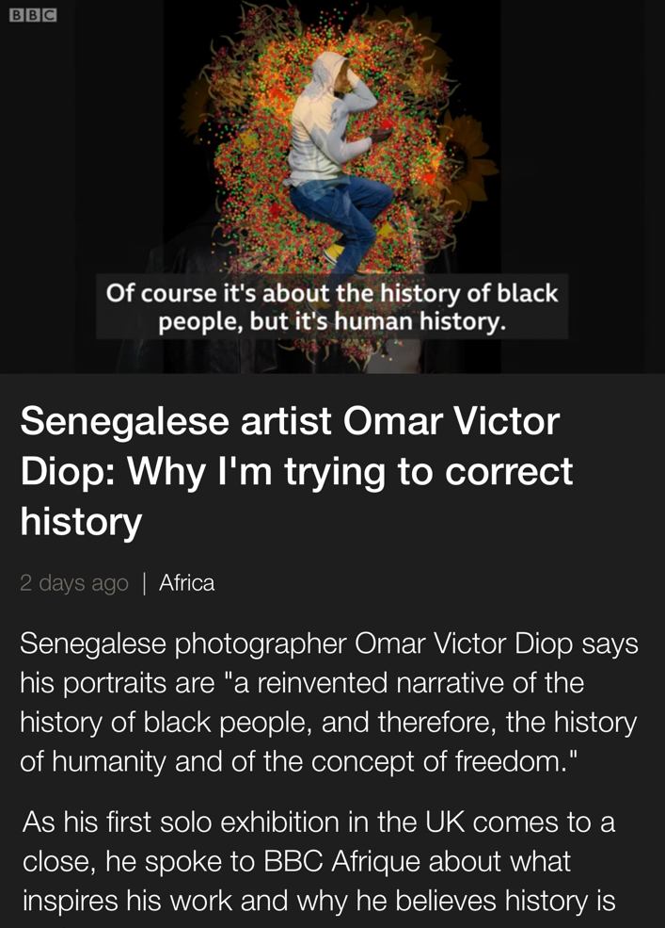
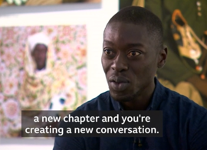

Slide 14

My path to scholarship began when I enrolled in Infants One as a pupil in 1950, not many years into my living age. (p. 597)
Before I was recruited to teach in Yaounde, neither Cameroun nor African history was really taught in the department… All that was taught was European, Asian and North American history. (p. 602)
Prof. Verkijika Fanso
Notes:
Note: Prof. Verkijika Fanso was a Visiting Scholar at Grinnell College in Grinnell, Iowa, USA in 2004.
Quotes from Prof. Fanso’s “A Thank You Valediction” (Chapter 27 of this 2013 book).
Valediction = farewell greetings on an important occasion
Please see handout about:
The Distortion of Cameroon History and
How Africa needs a new democratic formula
that beats the imposed the western multiparty system of governance

Slide 15
The Department of History in 1974
From 40
history students …
to 4000 today
From a few
women students …
to girls outnumbering boys in some departments
Notes:
Listen to Prof. Fanso here (p. 56 mn):
https://podcasts.ox.ac.uk/photo-archives-historical-resources-jeffrys-and-dalrymple-archives-compared
Professor Verkijika G. Fanso of Yaounde University in Cameroon compares two photo archives of the Bamenda Grassfields, both taken around the same time, which are now held in Cambridge and South Africa.

Slide 16
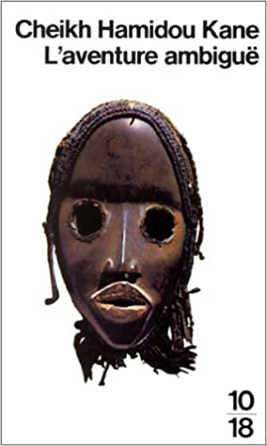
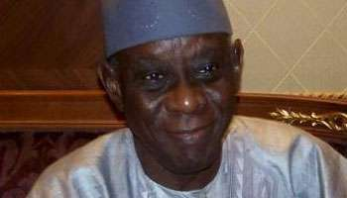
Je suis plus un témoin qu’un écrivain
www.jeuneafrique.com/183145/politique/cheikh-hamidou-kane-je-suis-plus-un-t-moin-qu-un-crivain
Notes:
www.youtube.com/watch?reload=9&v=OYA5JDfsJaM
Interview de l'écrivain Cheikh Hamidou Kane, 30 aout 2018
Cheikh Hamidou Kane est l'auteur de deux romans à succès, devenus des classiques de la littérature. En 1961, il publie « L’Aventure ambiguë », roman autobiographique dans lequel il relate la crise existentielle des premières générations d'Africains entrés en contact violemment avec la culture française, par la colonisation. Samba Diallo, le personnage principal, peine à réaliser la fusion pacifique entre son héritage peul, musulman et la civilisation occidentale qu'il a découverte à l'"école des Blancs". Puis viendra une suite du roman en 1995 avec « Les Gardiens du temple ». Auréolé de deux œuvres majeures, Cheikh Hamidou Kane s'est ensuite retiré de la vie littéraire. Il est devenu fonctionnaire international et ministre. Il a reçu le Monde Afrique à son domicile dakarois.

Slide 17

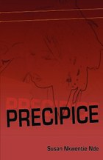
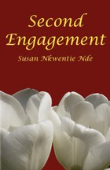
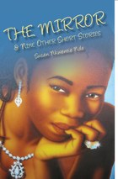
Notes:
Two novels and one book of short stories by
Susan Nkwenti Nde, a teacher at a bilingual high school in Cameroon.

Slide 18
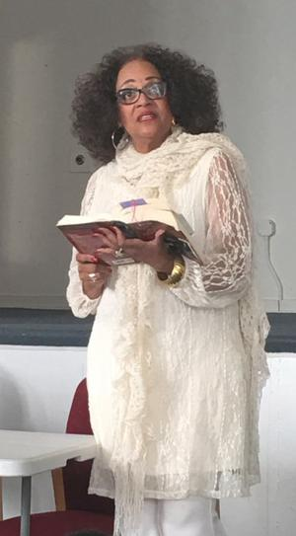
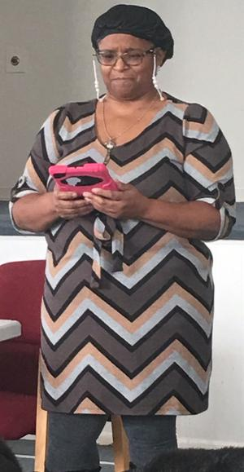
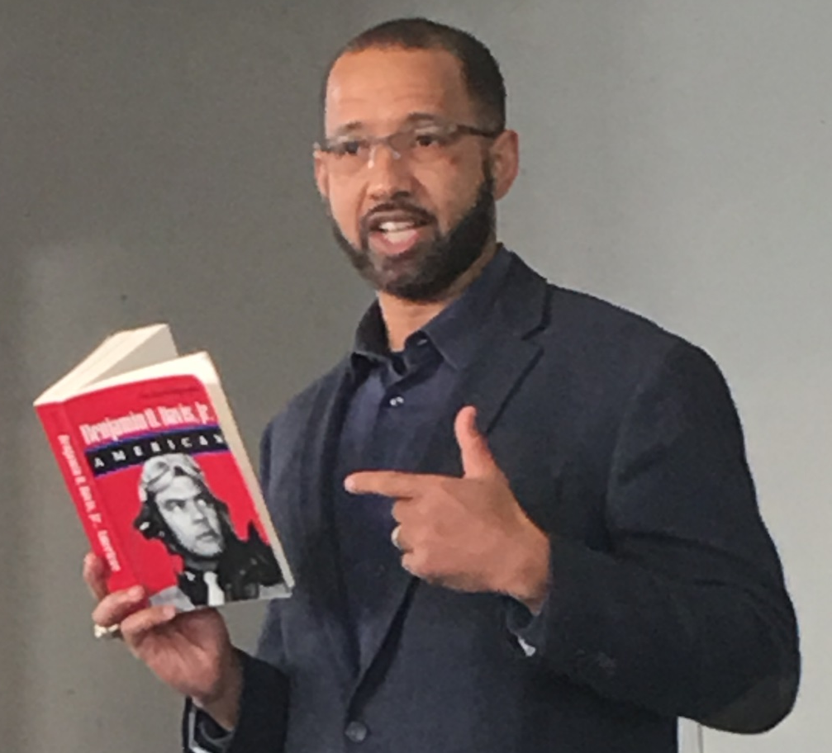
What if those works had not been written?
Notes:
https://www.amazon.com/Benjamin-Davis-Jr-American-Autobiography/dp/1560983957
Benjamin Oliver Davis Jr. was an American United States Air Force general and commander of the World War II Tuskegee Airmen. He was the second African-American general officer in the United States Air Force.
Dr. Cecelia Robinson,
Jordan R. Hollingswoth, and
Shelley Ibok at Garrison School Cultural Center,
African-American Read-In, February 5, 2017

Slide 19
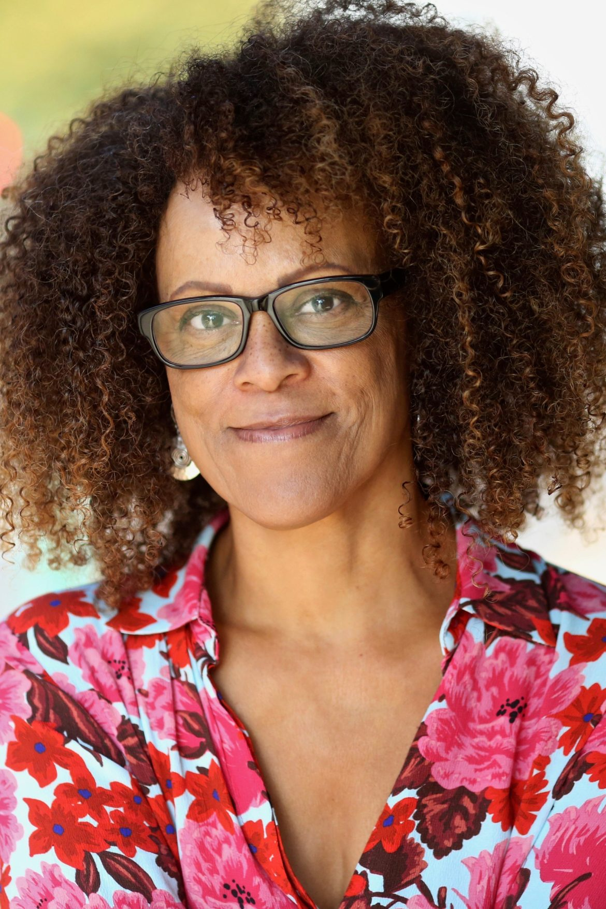
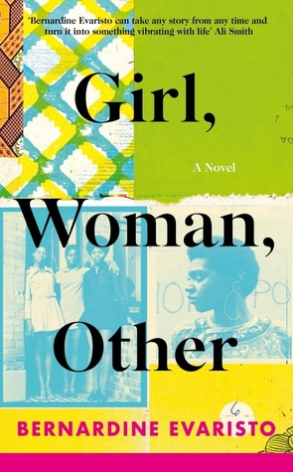
“The world is like a Mask dancing. If you want to see it well, you do not stand in one place.”
― Chinua Achebe
“The world is like a Mask dancing. If you want to see it well, you do not stand in one place.”
― Chinua Achebe
Notes:
www.langaa-rpcig.net/literature-can-foster-and-express-our-shared-humanity-bernardine-evaristo-on-the-importance-of-inclusive-publishing

Slide 20
“The world is like a Mask dancing. If you want to see it well, you do not stand in one place.”
― Chinua Achebe
“The world is like a Mask dancing. If you want to see it well, you do not stand in one place.”
― Chinua Achebe
Literature Can Foster and Express Our Shared Humanity
-- Bernardine Evaristo
I am passionate about broadening the narrative of who we are in Britain. In my novel Girl, Woman, Other, the twelve interconnected primarily black womxn are aged 19 to 93 and span a range of sexualities, classes, cultural backgrounds, occupations and family relationships.
My motto has long been to put presence into absence and black British women in particular tell me that they feel “seen” by this novel, while all kinds of other people have told me that they’ve gained insight into some of our life stories and experiences in this country, and also empathise with the characters, and even relate to them.
Notes:
www.langaa-rpcig.net/literature-can-foster-and-express-our-shared-humanity-bernardine-evaristo-on-the-importance-of-inclusive-publishing

Slide 21

“The world is like a Mask dancing. If you want to see it well, you do not stand in one place.”
― Chinua Achebe
“The world is like a Mask dancing. If you want to see it well, you do not stand in one place.”
― Chinua Achebe
Creative writing feeds scholarly writing
Scholarly writing feeds creative writing
Writing for non-academic audiences
feeds scholarly writing and vice versa
Vases communicantes

Slide 22

“The world is like a Mask dancing. If you want to see it well, you do not stand in one place.”
― Chinua Achebe
“The world is like a Mask dancing. If you want to see it well, you do not stand in one place.”
― Chinua Achebe
My understanding of complex concepts and theories can add substance to my use of storytelling. On the other hand, the imagination and creativity used in storytelling can be used to spark innovation in the use of theories in my academic writing and scholarly works. -- Margaret LoWilla Nyoka, 2019-2020 Early Career Fellow, African Leadership Centre

Slide 23
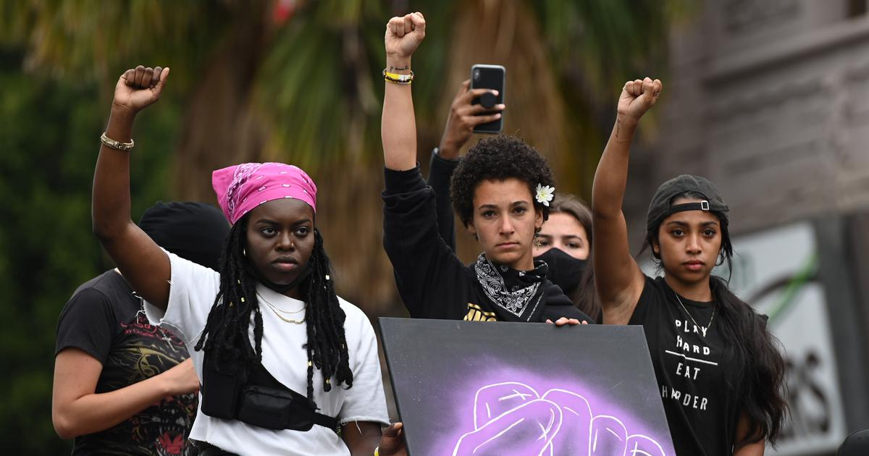

“The world is like a Mask dancing. If you want to see it well, you do not stand in one place.”
― Chinua Achebe
“The world is like a Mask dancing. If you want to see it well, you do not stand in one place.”
― Chinua Achebe
Why I took the knee at a #SayHerName
rally for racial justice in New York:
The campaign aims to draw attention to the US police violence meted out to black women and girls.
by Jael Silliman
Tuesday, June 9, 2020
https://scroll.in/article/964167/why-i-took-the-knee-at-a-sayhername-rally-for-racial-justice-in-new-york
Notes:
Writing consistently to inform and influence
The author is a retired professor of women’s studies, now writing regularly in the press. See next slide.

Slide 24
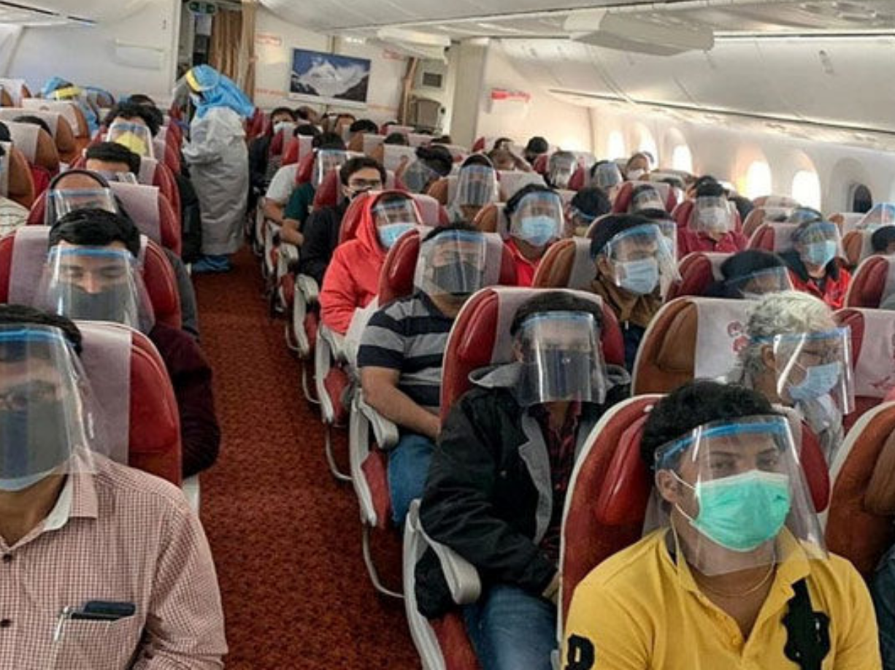
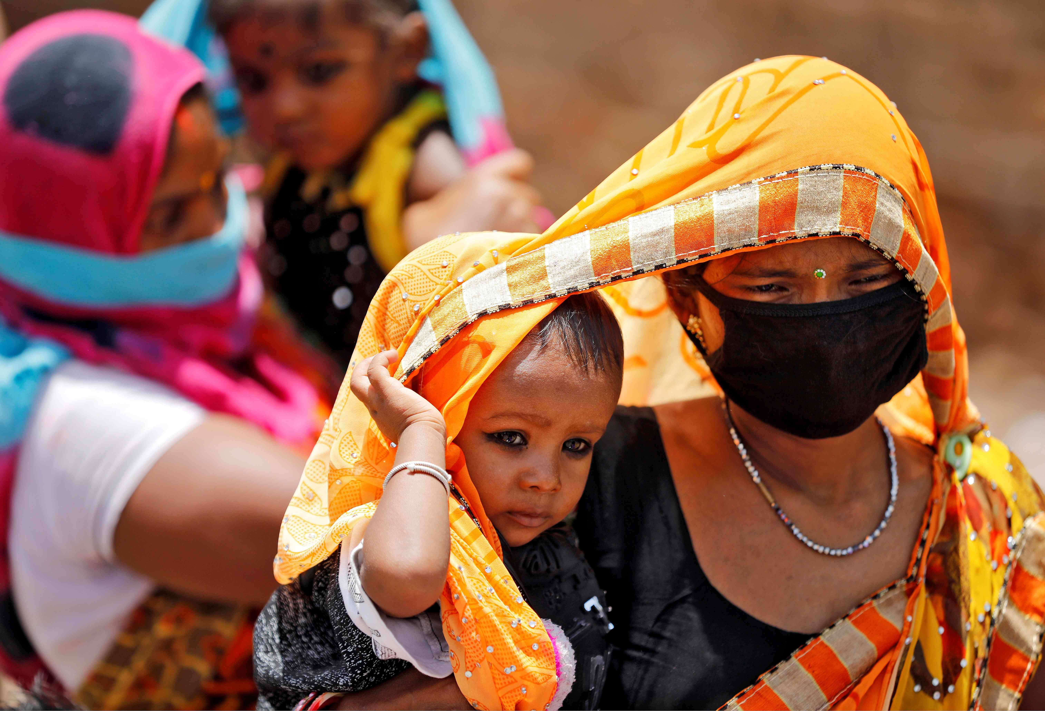
“The world is like a Mask dancing. If you want to see it well, you do not stand in one place.”
― Chinua Achebe
“The world is like a Mask dancing. If you want to see it well, you do not stand in one place.”
― Chinua Achebe
“I BELIEVE IN MIRACLES!” − ON THE VANDE BHARAT REPATRIATION FLIGHT
by Jael Silliman, June 2020
www.wotweb.com/wot-article/believe-miracles-%e2%88%92-vande-bharat-repatriation-flight
Lockdown: Images of migrants’ impossible journeys offer glimpses of grit and courage
June 20, 2020, by Jael Silliman
https://scroll.in/article/963014/lockdown-images-of-migrants-impossible-journeys-offer-glimpses-of-grit-and-courage
Notes:
“I had planned to leave New York City for Kolkata by the end of March. On March 24th Prime Minister Modi announced a total lockdown in response to the Covid pandemic. All flights in and out of the country ceased, as did domestic flights, trains, and busses. As months rolled by the chances of returning to Kolkata seemed distant. By late May Vande Bharat flights started repatriating stranded Indians across the world. In early June Overseas Citizens of India (OCIs), like me who faced emergency situations, were permitted to apply for these missions.”

Slide 25
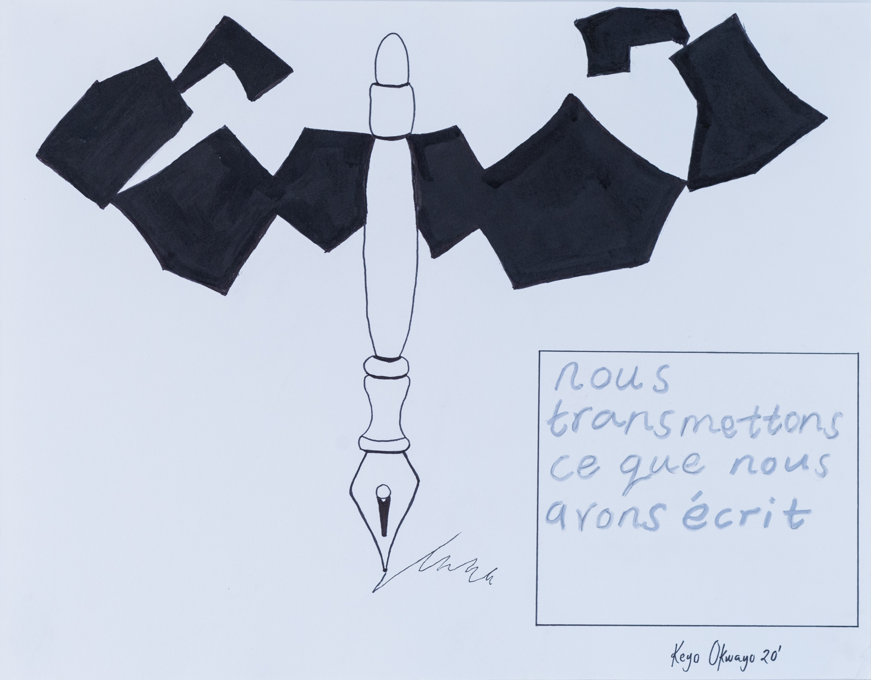
“The world is like a Mask dancing. If you want to see it well, you do not stand in one place.”
― Chinua Achebe
“The world is like a Mask dancing. If you want to see it well, you do not stand in one place.”
― Chinua Achebe
Notes:
This drawing by Kenyan artist Keyo Okwayo will be incorporated into a book by Nelkem Jeanette Londadjim, from Chad, to be published by Langaa Research and Publishing in 2020.

Slide 26
2. What to write?

Slide 27

What have you already written for non-academic audiences?
What do you want/hope to write in the future for non-academic audiences.

Slide 28
“The world is like a Mask dancing. If you want to see it well, you do not stand in one place.”
― Chinua Achebe
“The world is like a Mask dancing. If you want to see it well, you do not stand in one place.”
― Chinua Achebe
Connecting Science and
Writing for Non-Academic Audiences
Connecting fiction and ethnography can help bring out the perspectives of those neglected by mainstream scholarship.
Nyamnjoh, F. (2012). Intimate Strangers: Connecting Fiction and Ethnography. Alternation, 19(1), 65-92.
http://alternation.ukzn.ac.za/Files/docs/19.1/06%20Nya.pdf

Slide 29
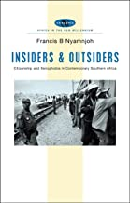

Notes:
“Here I reproduce excerpts from several chapters of Intimate Strangers (Nyamnjoh 2010), an ethnographic novel constructed from the same dataset that contributed to the writing of the scholarly book, Insiders and Outsiders: Citizenship and Xenophobia in Contemporary Southern Africa (Nyamnjoh 2006).”

Slide 30
“The world is like a Mask dancing. If you want to see it well, you do not stand in one place.”
― Chinua Achebe
“The world is like a Mask dancing. If you want to see it well, you do not stand in one place.”
― Chinua Achebe
African fiction provides alternative and complementary ethnography of the everyday realities and experiences of Africans and their societies in a world of interconnecting local and global hierarchies.
Notes:
I suggest that fiction as a genre is adapted to exploring such realities and complementary to scholarly ethnographic writing.
What do we gain in connecting ethnography and fiction? Deeper social science for one thing. The lived lives of those who are not of the dominant race, place, culture, class, place or age are often swept to the side lines of scholarship – and given voice in alternative spaces, such as music and literature (see Nyamnjoh 2011 for further development of this argument). Thus relying on ethnographic fiction as a legitimate source to inform investigations of social phenomena allows the researcher to embrace a wider variety of perspectives and provide more nuanced and most often more accurate accounts and explanations – instead of uncritically reproducing dominant social constructs. As historian James Giblin (1999) – who has his history students read novels by African authors – explains:

Slide 31
“The world is like a Mask dancing. If you want to see it well, you do not stand in one place.”
― Chinua Achebe
“The world is like a Mask dancing. If you want to see it well, you do not stand in one place.”
― Chinua Achebe
Dipping into fiction can
bring voice to silenced spaces
and
help science bridge
rather than reinforce
socially constructed difference.
Notes:
Relating the results of ethnographic research in the form of fiction can make the work – in which society at large has certainly invested in various forms – available to readers beyond scholarly circles. I have found that even scholars, when they read research results delivered in a novel as opposed to a scholarly paper, relate to the results in a more visceral way.

Slide 32
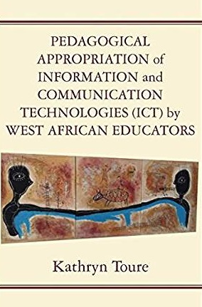
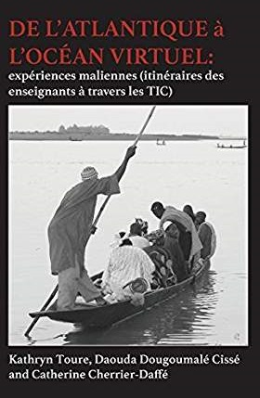
Notes:
1st book was making PhD research findings accessible – to scholarly audiences.
2nd book was to make the work accessible to teachers in Mali – w narratives from the teachers interviewed, to “open up” their practice and inspire other teachers.
Both books, like the previous example, drew on the same dataset.

Slide 33
Writing and Sharing Lived Experience

Slide 34
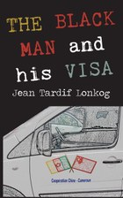
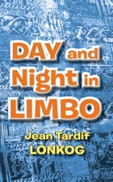
Notes:
The Black Man and his Visa, 2013, 102 pages, $7.45 (Amazon prime)
Day and Night in Limbo, 2014, 108 pages, $9.61 (Amazon prime)
Jean Tardif Lonkog was born in Santa, in the North West Region of Cameroon. He went to high school not far from home, at the Cameroon School of Arts, Science and Technology in Bambili, where he read the arts and graduated in 1993. In 2001-02, he attended the Mbengwi government teacher training college, and then taught locally in schools from 2002 to 2004. He travelled to China in 2005 where he taught English and learnt traditional Chinese medicine until 2008 when he returned to Cameroon. He is now a schoolteacher in the north of Cameroon. He also practices traditional Chinese medicine. He is studying for a bachelor’s degree in sociology via distance learning. He is married and a father of one. The Black Man and his Visa is his first book, and he hopes to keep writing.

Slide 35

Coffee was close to my grandfather’s heart
Independence meant that my grandfather could now work on his coffee farm. He knew each of his coffee trees. (p. 5)
Traversing hills and valleys with sacks of coffee
My aunt knew how to keep everyone engaged
during coffee harvesting. She would tell stories that ensured that no one was left behind...
The factory was about seven kilometres away. (p. 10)
Why is development measured in terms of consumption?
The theories of development and episodes of disempowered peasants are written down by people who are kept awake by coffee.
A kilogram of coffee fetches 2000 times
what my father receives in payment.
Notes:
Coffee was close to my grandfather’s heart; he knew each of his trees
Independence meant that my grandfather could now work on his coffee farm.
He knew each of his coffee trees. (p. 5)
My aunt did not have a coffee farm of her own
When weeding: The movement of her hands
would go with the movement of her hips.
The movement of her body rhymed with the song I Ave Maria
which she loved to sing at the top of her voice. (p. 6)
Coffee manuring season
My aunt adjusted to life according to the farming seasons.
She was very dynamic.
During the coffee manuring season, she would wake up early in the morning…
She would put the manure in a sack,
strap the sack using a rope and hoist it onto her back,
to climb the hill to the coffee plot
where she would drop her load and
sprinkle the green manure close to the coffee tree.
Traversing hills and valleys with sacks of coffee
My aunt knew how to keep everyone engaged
during coffee harvesting.
She would tell stories that ensured that no one was left behind...
The factory was about seven kilometres away. (p. 10)
“Development” paradoxes – working and trading in distorted markets
Why is development measured in terms of consumption?
The theories of development and
episodes of disempowered peasants
are written down by people who are kept awake by coffee.
A kilogram of coffee fetches 2000 times
what my father receives in payment
So much is packed into these 32 pages!

Slide 36
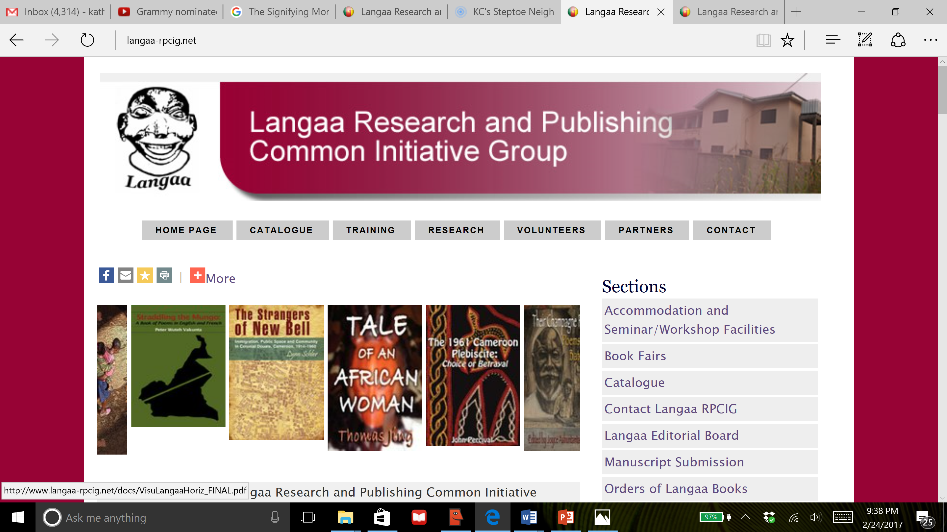
Notes:
In 10 years, Langaa has published over 500 books on Africa,
now available in libraries and personal collections throughout the world.
The mission of Langaa is to contribute to the cultural development and renaissance of Africa.
This is achieved by conducting research, coordinating training in research and writing, and publishing.
Our vision is a world in which the enhanced circulation of African worldviews,
positively shapes the evolution of humanity.
See: www.universityworldnews.com/post.php?story=20170919101008762

Slide 37
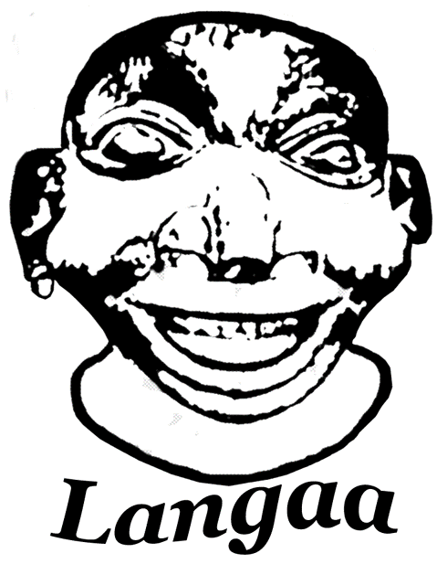
Notes:
Langaa short version: Langaa means desire and in the case of
Langaa Research and Publishing, a desire for knowledge.
Langaa longer version: Langaa refers to “a heightened desire” or thirst
which in the case of research and publishing
is a heightened desire for knowledge and learning
through reading, writing, culture and self- and community cultivation.

Slide 38
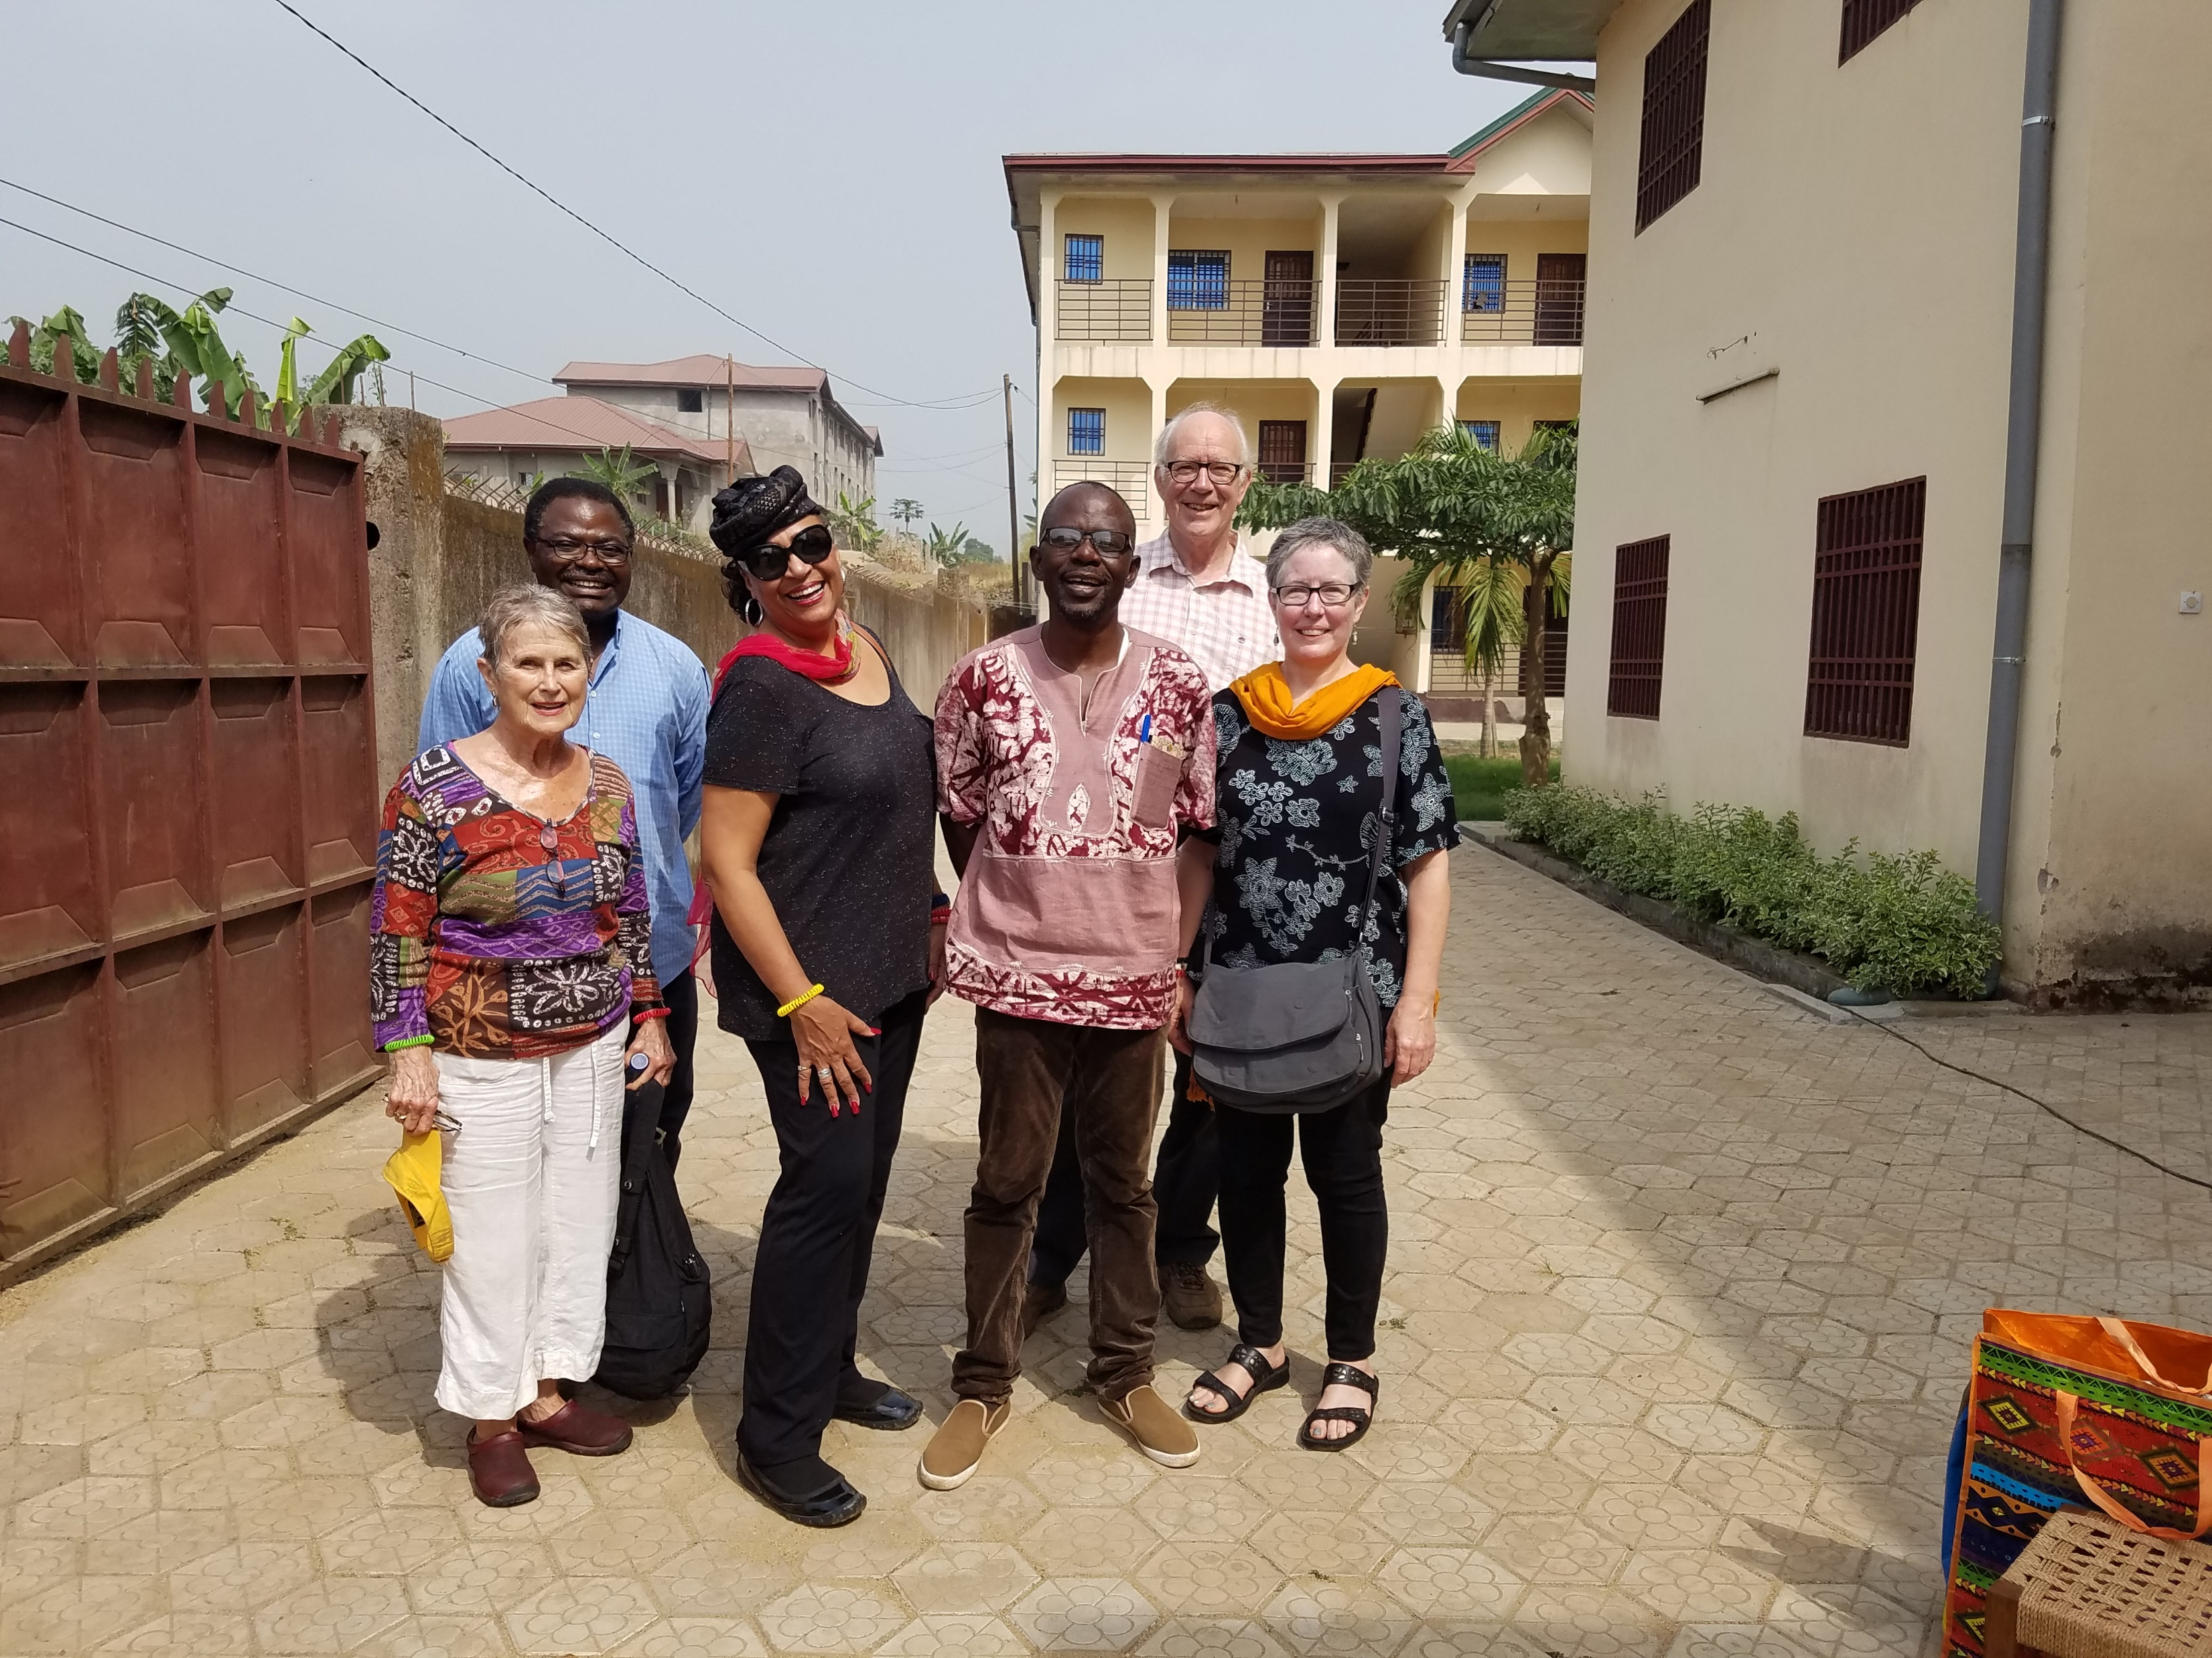
Langaa achievements
500+ titles in 10 years
  English, French, pidgin, etc.
  Non-fiction and fiction
  Print-on-demand, eBooks
  Thanks to international network
  of reviewers, editors, designers, etc.
  Non-fiction and fiction
  Distribution through
  African Books Collective
300 authors, from Africa and beyond
  Women and men
  Junior and seasoned scholars
Notes:
Picture – at Langaa in Buea, Cameroon

Slide 39
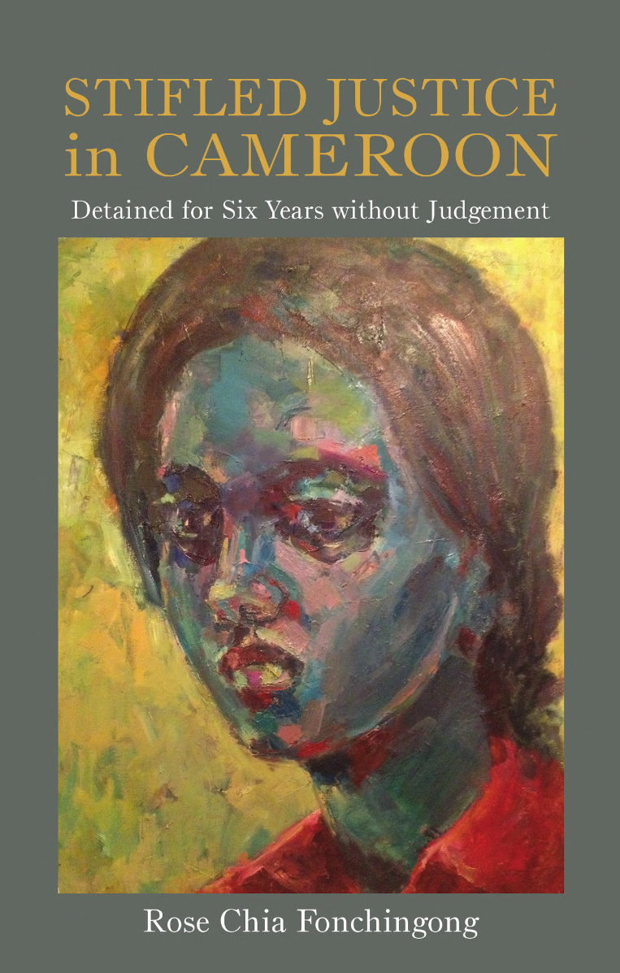
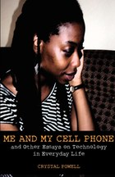
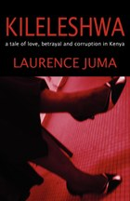
Circulation of African Worldviews

Slide 40
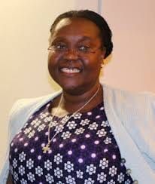
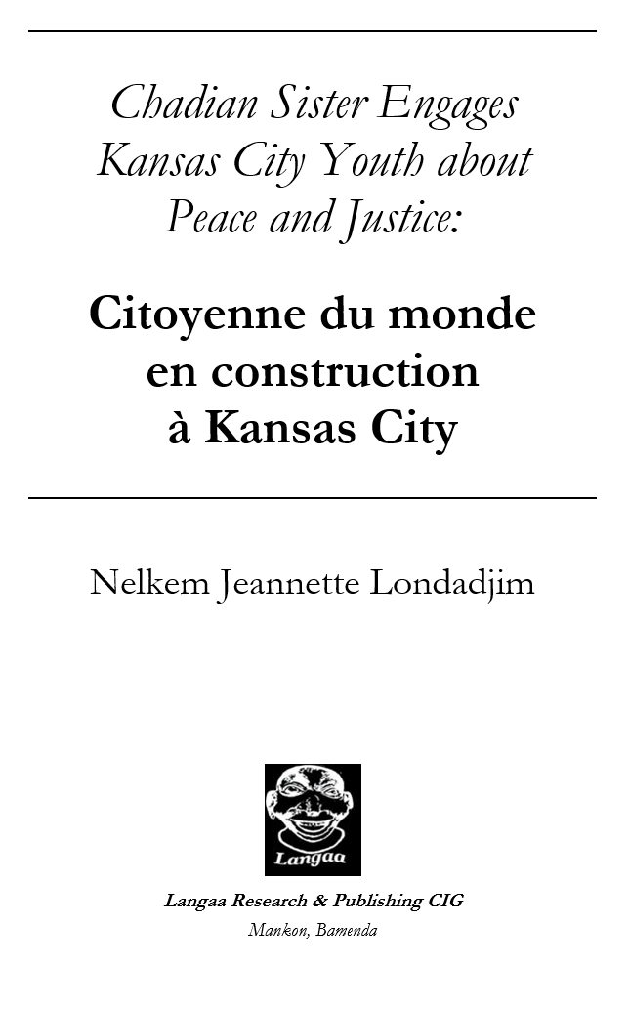
“The world is like a Mask dancing. If you want to see it well, you do not stand in one place.”
― Chinua Achebe
“The world is like a Mask dancing. If you want to see it well, you do not stand in one place.”
― Chinua Achebe

Slide 41
“The world is like a Mask dancing. If you want to see it well, you do not stand in one place.”
― Chinua Achebe
“The world is like a Mask dancing. If you want to see it well, you do not stand in one place.”
― Chinua Achebe
Forthcoming in 2020 with
Langaa Research and Publishing
This book is a microcosm of
Sister Nelkem Jeanette’s time and reflections
as Activist-in-Residence
at Avila University in Kansas City, USA.
She takes the reader on a journey
of faith, hope, interculturality,
and ways in which peace and nonviolence
can be actualized in local and global venues.
Notes:
« Il n’y a pas de paix sans justice. Mais il n’y a pas de justice sans parole échangée. Faire jaillir la parole a été ma seule action pour la paix, la justice et la non-violence ! »
« Conscients de vos préjugés, vous pouvez être au service de vos prochains là où la vie vous conduira, riches de cette culture de la vie acquise à Avila ! »

Slide 42

www.langaa-rpcig.net/writing-and-sharing-human-experiences-of-covid-in-east-africa-call-for-potential-book-chapters

Slide 43
Creative Writing – Fiction

Slide 44

A tale of love, betrayal and corruption in Kenya
In this page-turning novel, African traditions and modern judiciary overlap to complicate and tear further apart a struggling couple
Notes:
Laurence Juma was born in Kenya.
He now lives with his family in Grahamstown, South Africa,
where he teaches law at Rhodes University.

Slide 45
Oral Herstory / History

Slide 46
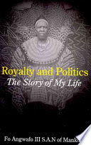
Royalty and Politics is the fascinating autobiographical account of a life rich in controversy, leadership, service, achievement and innovation.
Notes:
www.amazon.com/Royalty-Politics-Story-My-Life/dp/9956558311

Slide 47
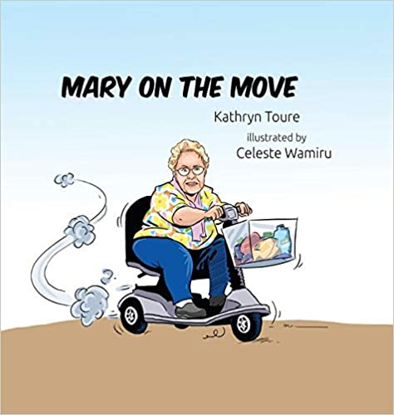
Notes:
www.kshb.com/entertainment/kcl/meet-the-author-and-illustrator-of-mary-on-the-move
www.amazon.com/Mary-Move-Kathryn-Toure/dp/1733026649

Slide 48
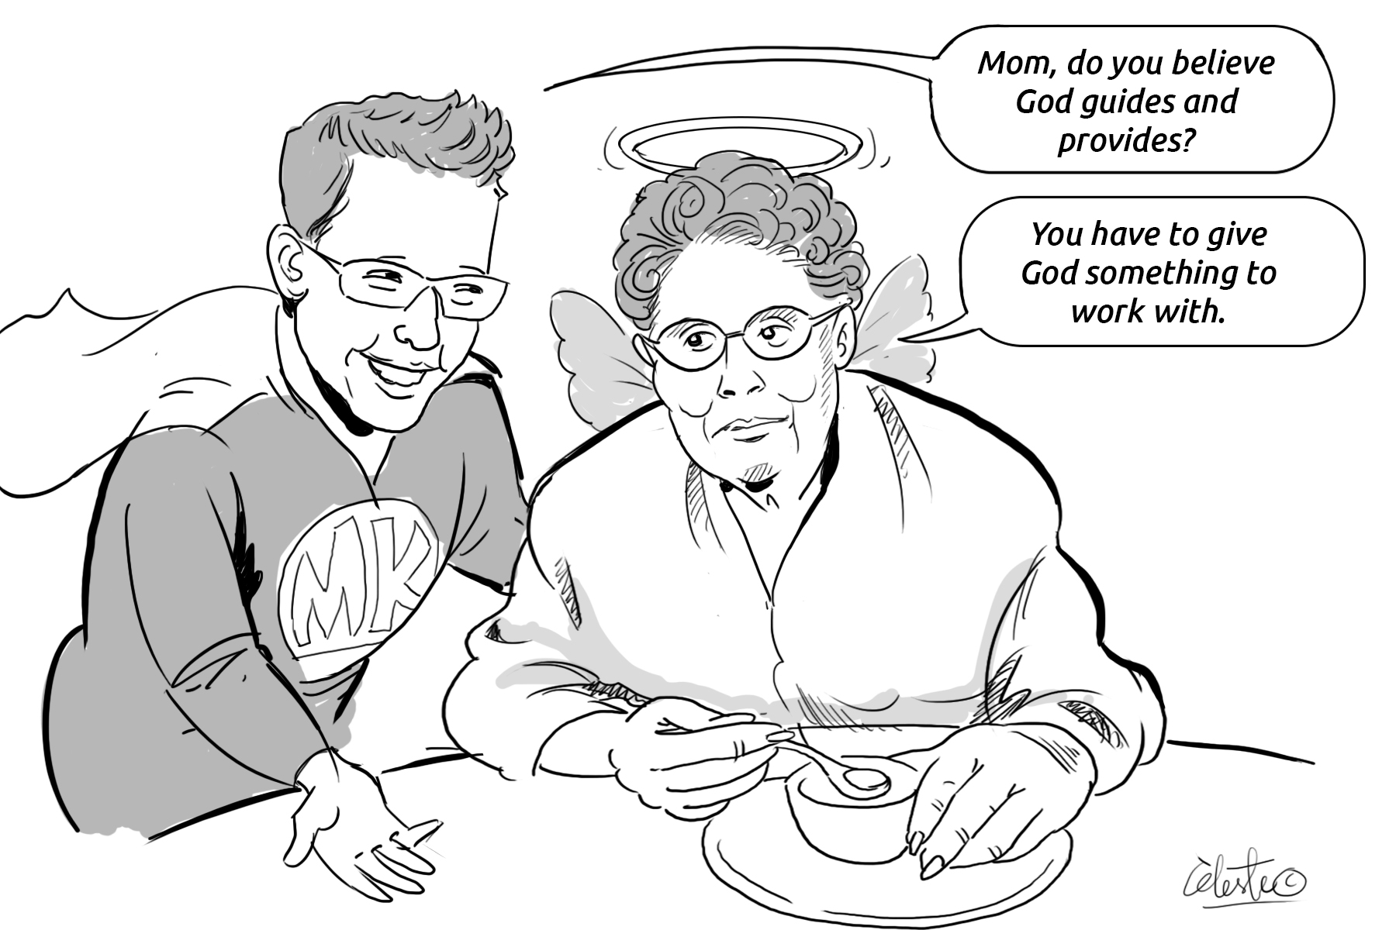
Notes:
I documented the quips from Mom, in “Notes” on my cellphone (under “Things Mom says”), over about a three years. Once we started on the book, it took about a year to complete it.

Slide 49
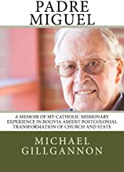
Notes:
www.amazon.com/Padre-Miguel-Missionary-Postcolonial-Transformation/dp/0999608827
The story of Padre Miguel, from Kansas City, who spent almost four decades in Bolivia, was gathered via six one-hour conversations that were subsequently transcribed. His memoir was then structured based on the content of the transcriptions. And he approved the text before it went for publication. He worked for the translation into Spanish to come out in 2020.
Respect our elders – one hour of talking at a time should be the limit. It takes a lot of energy.
Such intergenerational work is rich, for the interviewee and the interviewer.

Slide 50
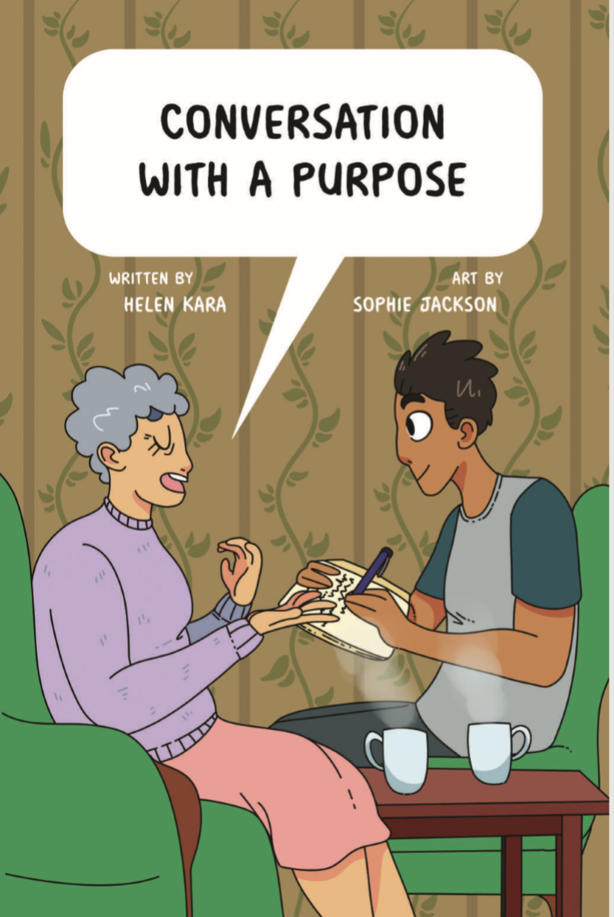
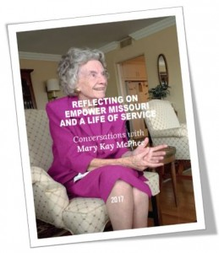
Notes:
The story of Mary Kay McPhee of Kansas City was gathered by Joanne Grace Farmer and Kathryn Toure over three one-hour conversations. So rich!
www.kathryntoure.net/2017/12/25/reflecting-on-empower-missouri-and-a-life-of-service-conversations-with-mary-kay-mcphee
Joanna: We’ve done a lot of talking, and we really appreciate everything we’ve been learning, because a lot of it’s new to us. Kathryn and I, in our discussions, have been like wow, we didn’t know that.
Mary Kay McPhee: About Empower Missouri?
Joanna: And about your life. Mary Kay McPhee: Oh [giggle]. Wow.
Kathryn: We are two curious women with question marks still coming out of our heads, but we promised ourselves to never go over one hour in our sessions with you, to respect your time, and our energy level. We’re at 58 minutes... Mary Kay McPhee: (laughter) Do I love you or what? I want you on my team. Joanna: We are on your team.
Mary Kay McPhee: Love it, love it. Is there something I need to be working on? Something I need to prepare for next time?
Kathryn: Your life has prepared you for these sessions. And we thank you for conversing with us today.
When we went to see Mary Kay after she reviewed the first draft of this document, she thanked Empower Missouri immensely for the time to reflect and said that everyone should have such an opportunity. Let’s continuing talking with our elders!
Joanna Grace Famer, Scholar, Activist and Community Capacity Builder
Kathryn Toure, Researcher and Writer
Neil Tucker, Videographer
Please note that any factual or historical errors are not the responsibility of Empower Missouri but of the authors of this document.

Slide 51
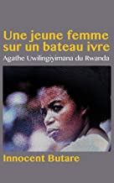
Agathe Uwilingiyimana served as Prime Minister of Rwanda from 18 July 1993 until her assassination on
7 April 1994, during the opening stages of the Rwandan Genocide.
She was Rwanda's first and, so far, only female prime minister.
Notes:
www.amazon.com/s?k=Agathe+Uwilingiyimana+innocent+butare&i=stripbooks-intl-ship&ref=nb_sb_noss

Slide 52

Supporting Others to Write
Notes:
What is pictured here (and described below) is a good example of inquiry-based learning at middle school level. The students developed their research questions (one per researcher), developed their interview questions, conducted interviews, troubleshoot with each other workshop style, and helped each other out with finding good titles for their write-ups which are collected here.
www.kathryntoure.net/2009/01/03/travaux-des-jeunes-chercheurs-de-kalanso-a-bamako-au-mali
Toure, K., Dolo, S., Dembélé, O.O., Ouattara, K. (Eds). (2008). Travaux des jeunes chercheurs de Kalanso à Bamako au Mali. Collection de 13 rapports de recherche des élèves de l’atelier de recherche de 7ème année.
Travaux des jeunes chercheurs de Kalanso à Bamako au Mali
Ce fondement de la pédagogie active dont Adolphe Ferrière fut le précurseur au début du XXè siècle est aussi celui de l’atelier Initiation à la Recherche initié par Kathryn Touré (chercheur en éducation) en octobre 2007 à Kalanso avec des élèves de 7ème année. L’atelier est une application concrète de cette perspective pédagogique toujours prônée dans l’enseignement mais rarement tentée.
Les élèves volontaires, mais qui n’avaient pas une idée claire de ce qui les attendaient, ont chacun choisi un thème de recherche. Ils eurent rapidement des réponses aux questions que leurs camarades leur posaient par rapport à ce thème et étaient prêts à rédiger un rapport dès la première séance comme on fait, en classe, une rédaction sur un sujet donné.
Mais la démarche était toute autre …
Les animateurs Oumar Ousmane Dembélé, Saniélou Dolo, Karounga Ouattara (professeurs de lettres) et Kathryn Touré ont embarqué les élèves dans un parcours plus long (à raison d’une séance par semaine jusqu’en avril) mais beaucoup plus riche en terme d’apprentissage.
Ainsi, au cours de la 1ère phase, chacun tente, guidé par les animateurs, de formuler, de clarifier l’énoncé de son thème de recherche puis d’identifier les tâches à mener selon la technique d’enquête choisie.
Pendant la phase 2, chacun réalise son enquête à travers des interviews, des questionnaires écrits et même des visites de sites en rapport avec le thème de recherche. Mais confrontés à la réalité du terrain d’enquête, certains sont amenés à revoir leur projet pour le faire évoluer dans une autre direction.
Le travail de synthèse, de rédaction et de saisie informatique du compte-rendu est alors entrepris. Cette 3ème phase révèle à chacun tout ce qu’il a appris sur son thème depuis le premier jour de sa recherche où il pensait avoir déjà toutes les réponses aux questions.
Cette démarche didactique à la fois individuelle et collective, combine l’exercice de la formulation verbale et écrite, la pratique des techniques d’enquête, l’apprentissage en collaboration avec ses pairs. Elle donne le goût d’approfondir ses connaissances par la méthode expérimentale pour laquelle elle constitue une formidable formation.
Nadine Sanoh, Directrice de Kalanso 2
Toure, K., Dolo, S., Dembélé, O.O., Ouattara, K. (Eds). (2008). Travaux des jeunes chercheurs de Kalanso à Bamako au Mali. Collection de 13 rapports de recherche des élèves de l’atelier de recherche de 7ème année.

Slide 53

community inquiry
Notes:
www.kathryntoure.net/2017/11/18/do-you-know-this-missouri-history
This is an example of working with students in a spirit of community inquiry. The community learned black history from the students when the students presented their work and had it displayed at the public library.
I was honored to work with students, teachers, school administrators and community members to deepen understanding of history and culture. Hope you are inspired and learn something insightful and useful in browsing through “Do You Know this Missouri History?” by Liberty North High School juniors of Black Students United. So proud of our students!
https://ccaal-garrisonschool.org
Garrison School was established in 1877 to educate black youth of Liberty, Missouri, USA. Clay County African American Legacy, Inc. purchased the building from the Liberty School District in 2003, and today it serves as a site for activities of Garrison School Cultural Center, which preserves history, celebrates culture, and promotes human relations.

Slide 54


Notes:
Rose is a medical doctor. When she was heading up a government-sponsored
HIV/AIDS project, she was arrested for embezzlement of funds.
She is from English-speaking Cameroon and was imprisoned in the Central Prison of Yaounde, the capital city of Cameroon,
in a French-speaking province.
After six years, it was determined in court that she was innocent of the embezzlement of which she had been accused.
In her book about these experiences, she describes
horrific living conditions in prison and horrible dreams,
saying one should never wish imprisonment on your worst enemy.
She writes about being more informed about Cameroon while in prison than when out of prison.
She goes on to explain how cellphones collapsed “the Chinese wall between prison and the outside.
Even though cellphones were forbidden in prison,
prisoners kept them and kept changing their hiding places so warders
hopefully wouldn’t find them.

Slide 55
Incompetence and indifference are a nightmare in broad daylight of the judiciary. (p. 65)
How could I convince anyone that some of us were only used as smokescreens to show the outside world that the government was fighting corruption? (p. 78)
I was struck that the Anglophone does not have a say in this country.
[At court,] I was asked to only speak in French… Here I was, struggling to be heard and defending myself in a foreign language.
I felt like a stranger in my own country. (p 84)
Notes:
www.amazon.com/Stifled-Justice-Cameroon-Detained-Judgement/dp/9956763764

Slide 56
Religion helped me a lot in prison, and I came out of there a better person. (p. 90)
What you use as an anchor while in prison makes all the difference. If I went there with nothing to hold on to, I may not have survived. I had family to hold on to. I had a daughter to hold on to. I kept thinking about my family outside. (p. 93)
Having had my patience tested to the limit in prison, what annoyance could I possibly find out here that I haven’t experienced in there? … I no longer find anything that makes me tense and angry. … I think I outgrew the anger that I used to have before I went to prison. (p. 90)
Notes:
So much shared – in just 102 pages, in a book published in 2016.

Slide 57


Notes:
www.youtube.com/watch?v=WvhgqcUA-2A
Published on Aug 18, 2016
It is not unusual to find pregnant women convicted or awaiting trial in Cameroon’s prisons. Since the beginning of this year, there are indeed 8 pregnant women at the Yaoundé Central Prison. They live in precarious conditions and have a limited access to prenatal medical care, and the resources necessary to conduct their pregnancy. Other women have no other choices but to live with their toddlers in prison. These women, who represent the most vulnerable group of the inmate population, have become one of the main targets of REPCAM, an organization run by Claire Ndi Samba, that The provide them with material, financial and psychological support.
Read the full story here: https://femmeslumiere.com/en/stories/...
Il est fréquent que des femmes enceintes, en attente de jugement ou condamnées, se retrouvent derrière les barreaux au Cameroun. Depuis le début de l’année, on compte en effet 8 femmes enceintes à la prison centrale de Yaoundé. Celles-ci vivent dans des conditions précaires et ont un accès restreint aux visites médicales prénatales et ressources nécessaires au bon déroulement de leur grossesse. Certaines femmes sont parfois contraintes de vivre avec leur nourrisson en prison n’ayant pas d'autres choix. Ces femmes, qui représentent aujourd’hui la couche la plus vulnérable de la population carcérale, sont devenues l’une des cibles principales du REPCAM, une organisation dirigée par Claire Ndi Samba, qui leur apporte une assistance matérielle, financière et psychologique.
Découvrez son histoire: https://femmeslumiere.com/histoires/c...

Slide 58

“The world is like a Mask dancing. If you want to see it well, you do not stand in one place.”
― Chinua Achebe
“The world is like a Mask dancing. If you want to see it well, you do not stand in one place.”
― Chinua Achebe
Poetry
Quand tu es découragé
Ne reste pas assis sur ton tabouret
A regarder la vie défiler
Prends ton bâton de pèlerin
Bats-toi et avance
Pour réaliser les rêves que tu as en tête
Notes:
www.amazon.com/sont-mes-ailes-Where-Wings/dp/9956550795
You usually eat with your brother
And chat with him
Why let politicians upset that fraternity?
When you finish fighting with your brother,
After wounding him, what’ll you do?
Is it then you’ll ask for pardon
After already having caused him harm?
Why not pardon him right now
Before any harm is inflicted?
Let politicians do their politicking

Slide 59

Lawino instructs us in Acoli customs…
And you use your right hand
Even if you are left-handed:
This is good manners.
Only rude fellows
Use their left hands
For breaking millet bread.

Slide 60
Ocol calls for change…
Listen
My sister from Ankole
And you from Ruanda
And Burundi,
Here’s a hammer,
Smash those pots
Of rotten milk
Burst open the door
Come forth into daylight…
Are you a caterpillar
For wasps
To lay their eggs in?
Who told you
That your fertility
Will be enhanced
By excessive fatness?

Slide 61
3. How to write?

Slide 62



Read Read Read …

Slide 63





Notes:
Painting of man:
Old Book by Leroy Campbell, born in Charleston, South Carolina in 1956
http://readingandart.blogspot.com/2013/09/leroy-campbell.html
https://www.leroycampbelloriginals.com

Slide 64




Slide 65
How to Write
Read Read Read, read others, read peers…
Practice Practice Practice
Have others review your work; do the same for them (writing relationships)
Become a reviewer (networks)
Take notes Collaborate Get started!

Slide 66
Writing of the text
First lines of paragraphs = important
Sometimes less is more = avoid wordiness
Say what you mean
Several drafts
Put the manuscript aside for a while
Use spell check
Learn and use track edits when you review papers for others and vice versa

Slide 67

Pause…
Questions? Comments?

Slide 68

Three biggest takeaways from today.
What to improve / integrate going forward?

Slide 69


Examples of non-academic writing that has influenced the fellows
https://dppa.un.org/en/women-peace-and-security
www.theeastafrican.co.ke/scienceandhealth/Covid-driving-Kenyans-into-jaws-of-mental-health-issues/3073694-5581316-ir0nphz/index.html
www.the-star.co.ke/authors/kibii
Notes:
Reviews on Amazon regarding Kairaba – about Jawara, Gambia’s first Prime Minister (1965-1970) and
later first president (1970-1994):
“Thank you so much whoever sold me this book. A fascinating insight in to an important political era of a country emerging from colonial rule, and autographed by the ex-president himself! What an unexpected bonus. I lived in and am married to a Gambian and have this country ‘suma reini hol’ (in my heart) A truly humble leader and so far from the political elitism that is so engrained in the majority of ruling systems of this world.”
“An interesting memoir from the former president of The Gambia. The only slight disappointment is how the book tends to gloss over the reasons he chose to return to The Gambia following exile, his views on the current leadership and the ongoing effect the 1994 coup has had on ordinary Gambians.”

Slide 70









Notes:
Why write for non-academic audiences? The ALC fellows replied:
I want to write for non-academic audiences to impart knowledge in the communities where I work. Examples of non-academic writing that have impacted me are mostly pieces written by African women for African girls and women and which portray their real beauty in all its diversities.
I want to create awareness and address challenges and vulnerabilities. I want to make sense out of ideas and issues discussed to put pressure on policy makers to act.
I would like to write for non-academic audiences because that is how to reach the majority of people who are involved in decision making processes on a daily basis and that have existential implications for our world as we know it. Decision making is not only done at medium and senior levels. There is a huge need and demand for easily comprehendible but insightful information. Academic writing sometimes is like a conversation among academics; it excludes those that are not “in the knowing” or informed or specialised. I want to help share fresh perspectives and voices in ongoing discussions.
I have always been fascinated by the use of storytelling (in all of its forms) but most particularly in two ways. First, as a way of making meaning of the world around us. Second, as an escape from the world around us. Escapism allows for wander in the realm of imagination, which further fosters creativity and innovation. Academic terms, concepts and theories can be intimidating to people outside of academia, yet the theories taught in scholarly works can be useful in helping non-academics understand occurrences around them. My desire is to leverage opportunities that lie both in academic and non-academic work and writing.
Not everyone is an academic, and not everyone has the time or the ability to analyze an academic piece. It is essential to think about the different groups in society and engage with them. Academics tend to fall under the umbrella of theory and may forget the reality of things; therefore, I believe it is essential to sometimes leave the academic world and write or read non-academic works.
I want to write about terrorism and security issues for non-academics. Informing and educating the general public on such issues is critical for them to understand how to identify and report suspicious persons and items; helps avoid stereotyping of some communities as terrorists because there is no general profile of terrorists; and helps them understand their role in advocating for counter-terrorism laws that are humane and do not infringe on their civil liberties.
Writing for non-academic audiences will give me the opportunity to positively influence government policies in my area of interest – peace, security and countering violent extremism. This I can do by writing articles that are policy relevant to provide strategic insights and policy solutions to help decision makers make an informed decision. It will also enable me to educate the public on peace, security and countering violent extremism. In addition, I will receive valuable feedback and comments from the public on my writing. Through blog writing, I was able to inspire and influence young people on how to safeguard themselves from falling into Boko Haram violent extremism and becoming radicalised. This also increases public awareness of the violent acts committed by Boko Haram to individuals in North East Nigeria.
Writing can be both academic and non-academic, depending on the intended audience. Human experiences in terms of real-life stories have the potential to inspire people in many ways and can be presented in writing. The audience for non-academic writing is larger than for academic writing. Coming from a humble background, I love to share my story to inspire younger people determined to break barriers and reach their goals.
I’m still in the premature stage of my non-academic writing trajectory, but from the few non-academic pieces that I have produced, I have enjoyed it to a great extent. I think non-academic writing is important for various reasons. It engages with a wider scope of influence. One’s presence can transcend across various spaces, disciplines, and areas of research nationally and internationally. It is often free-flowing and reflects the style and personality of the writer, unlike academic writing that is more rigid. It is therefore more personified and engaging than academic writing. It is a window of opportunity for voices that have not been given a platform within the academic realm to create and narrate their stories. The three points mentioned above make up my motivation behind contributing to non-academic audiences. I can’t say a specific piece of writing influenced me; rather I am influenced by hearing my mentor speak about his non-academic writings. He is so passionate about it and always seeks to inspire through those pieces of work. I guess, to a certain extent, I want to use non-academic writing to influence and inspire the different audiences who come across my article(s)/writing(s).

