Slide 1
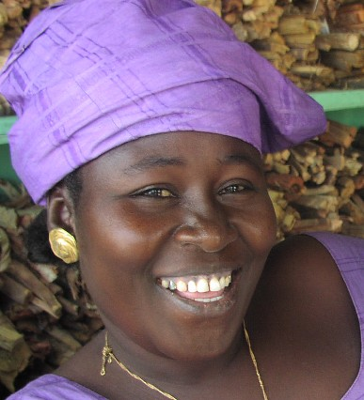
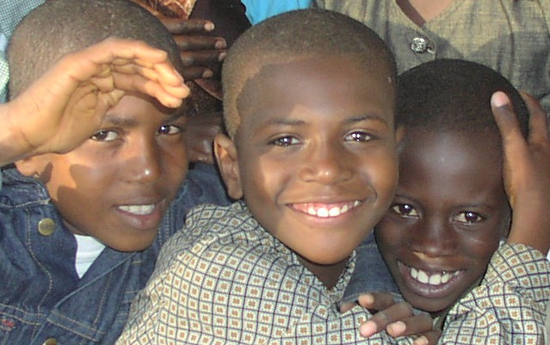
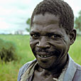
Research to Policy: Processes and Synergies
Meeting on Promoting Development through Research, Advocacy
and Policy in Africa: The Role of Grantmaking,
co-hosted by the Bill & Melinda Gates Foundation and Trust Africa
in Dakar, Senegal, March 24, 2009
Kathryn Touré and Elias Ayuk
IDRC Regional Director and Senior Program Specialist

Slide 2
International Development Research Centre
Founded in 1970 by Canadian Parliament : a Crown Corporation
Supporting researchers in Africa, Asia, and Latin America
7 offices throughout the world; 36 years of experience in Africa
80+ grantee institutions in West and Central Africa
Current program areas
Environment and natural resource management
Social and economic policy (Globalization, Growth and Poverty; Women’s Rights and Citizenship; Think Tank initiative; Peace, Conflict and Development, Governance, Equity and Health)
Information and communication technologies for development
Innovation, policy and science
Special Initiatives and Partnership and Business Development Divisions

Slide 3
IDRC approach
Local appropriation of research processes
Interdisciplinary approaches
On call mentoring available as needed
Encouraging networking to enhance learning, synergies and influence
Capacity building
Research skills: project design, data analysis, communications, writing, evaluation, etc.
Institutional strengthening: partnership development and management, negotiation, resource mobilization, financial management, etc.
Research to policy …

Slide 4
Research to policy
No one way, no right way
Not linear
Complex, multiform, and dynamic process
Decision
Policy
Knowledge
NOTE: Risks of overemphasis on policy impact
Notes:
RISKS:
Researchers are instrumentalized, e.g. by donors
Miss out on important layers of necessary knowledge
Research impacts policy but is then overturned and researchers did not document/publish for reinvestment of findings in future
Limiting the contributions of African researchers to science and to consideration of findings in other contexts

Slide 5
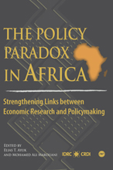
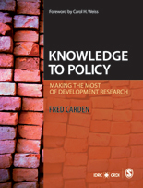

Slide 6
Bibliography
Researchers and Decision Makers in Africa: Synergies for Development
Written by IDRC Regional Advisors for West and Central Africa (4 women and 6 men)
Based on 22 case studies worldwide + 6 national workshops in West and Central Africa, 2004-2007
Notes:
The Council of Regional Advisors was put in place by the West and Central Africa Regional Office (WARO) of IDRC in 2001.
The thematic workshops (agriculture, education, private sector development, desertification, governance, health, etc.) were held in Senegal, Burkina Faso, Ghana, Mali, Cameroon and Benin).

Slide 7
Decision maker
Pragmatic
Needs solutions now
Plans for short and medium term
Wants sure answers
Unaware of research advantages and resources
Selective
High mobility in ministries
Impatient with too many questions and rigorous methodologies
Researcher
Academic (ivory tower)
Needs time
Envisions longer term
Prudent and nuanced
Unaware of policy processes
Too general or overly comprehensive
Eaten up by consultancies
Focus on research over communication
Doesn’t consider political feasibility
Too independent, even subversive

Slide 8
Obstacles to synergy
Inadequate research policy and environment
Lack of data and analysis
Contradictory research findings
Lack of communication
Limited connection with supposed beneficiaries
Political context
Economic pressures
Extraversion of research priorities and processes
Preference for foreign expertise
Institutional fragility and lack of political continuity
Notes:
*plus dependency on donors for financing, governments in sub-Saharan Africa, with the exception of South Africa, contribute only .3% of GDP to research, when research shows that a minimum of 1% of required for positive policy impact

Slide 9
Decision maker
Researcher
Notes:
Example of decision makers and researchers involved in PARALLEL processes: The national agricultural research institute organizes a national workshop on 20 different corn varieties that have been developed and tested for specific national contexts.
Shortly thereafter, the government imports corn seed massively.
If decision makers and researchers are involved in parallel processes, how do we create space for synergies?

Slide 10
Who is a/the decision maker?
Parliamentarian, government ministry staff
Decentralized authorities and elected officials
Civil society
Private sector
Farmers, teachers, poor people, parents, youth …
Notes:
In a context of democratization and decentralization, the decision maker is understood in the broadest sense.

Slide 11
How to increase synergy (1)
STRATEGIC ALLIANCES
Understand knowledge needs
Include policy outreach in project design
Link research process to policy process
Involve decision makers and research users (focal person, co-researcher, co-author)
Nurture relationships
Researchers, decision makers, parliamentarians, local authorities, religious leaders, civil society, NGOs, farmer associations, etc.
Develop platforms for dialogue (i.e. FIRST in Burkina Faso)
Networks, communities of practice

Slide 12
How to increase synergy (2)
VISIBILITY, ACCESSIBILITY, VALORISATION OF FINDINGS
Sustainable flow of information
Policy briefs
Media (not event coverage but partnerships)
Public dialogue
Web sites and online libraries
Publications
Databases (backed up), archives
Use of information and communication technologies (ICT)

Slide 13
How to increase synergy (3)
UNIVERSITY AND INSTITUTIONAL REFORM
Improve governance structures
Activate research advisory councils
Students linked to community needs
University campuses outside capital cities
Collaboration among universities to respond to regional needs
National and regional research funds
Notes:
EXAMPLE of improved governance of university research: NAMIBIA.

