Slide 1


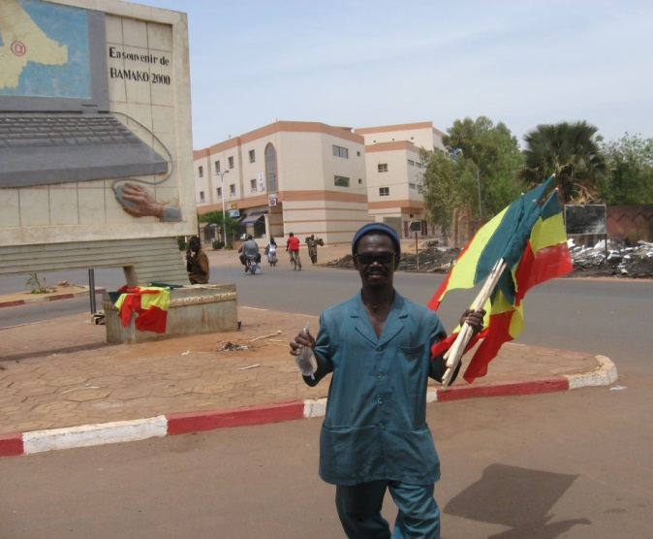
Forgerons d’internet dans les salles de classe en Afrique
Pour le 3e colloque international
en éducation : enjeux actuels et futurs
de la formation et profession enseignante,
Montréal, Canada, 6 mai 2016
Kathryn Touré, PhD
kathryn.toure@gmail.com
Notes:
J’argumente
dans cette présentation
que les forgerons d’internet sont présents et très actifs dans les salles de classe en Afrique.
I will be speaking in French, but I look forward to your questions in either French or English.
Avec votre permission, je vais présenter en français, mais j’attends vos questions en français et an anglais.

Slide 2
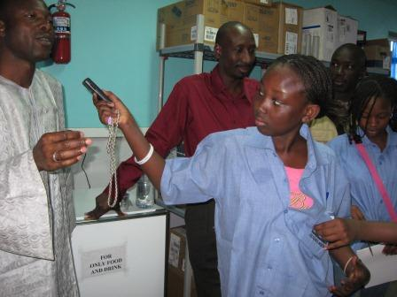
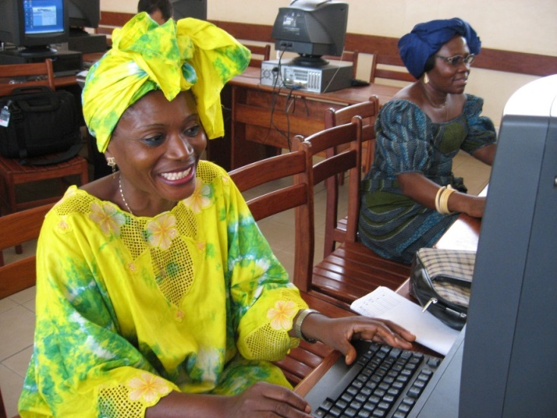
Rubriques de la présentation
Contexte
Question de recherche
Concepts
Méthodologie
Résultats
Conclusion
Notes:
Les rubriques de la présentation sont assez standards.
/
The outline of my presentation is rather standard.
I begin with the context and the research question,
before explaining concepts mobilized and the research methodology used.
I hope to invest most of the time presenting the research findings before concluding.
In the conclusion I will mention some limits of the study a some recommendations.

Slide 3
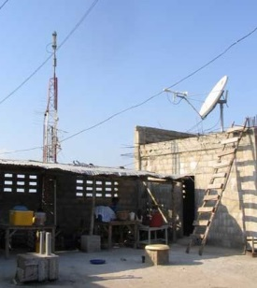
Contexte
L’éducation en Afrique
Influences indigènes et étrangers
L’écart entre la vie et l’école
Besoin des pédagogies qui facilitent
la régénération de la société
La prolifération des TIC
Connectivité à Internet,
utilisation des TIC dans l’enseignement
Les promesse des TIC?
Renouveau pédagogique? Apprentissage actif?
Notes:
Education in Africa
Education in Africa today
is the result of centuries of cultural encounters.
In indigenous African education,
school and life were one.
With an entire community responsible for teaching children,
through observation, storytelling
and engagement with everyday life (Moumouni, 1964/1998; Nsamenang, 1992).
In the 1100s (12th century), madrassas were introduced for the study of the Koran,
and today in Mali madrassas account for 17% of grade 1 through 9 schools.
In the 19th century, French colonists in West Africa
put in place formal education
to train Africans for the colonial administration.
African cultural initiative and imagination were suppressed (Fonlon, 2012; Nyamnjoh, 2004; SAC, 1965).
Learners experienced – and continue to experience – alienation and dualism.
Pedagogies for the times
In this context of disconnect between schools and their milieus,
and the devalorization of African cultures and values, African scholars (Dei, 2002a&b; Fonlon, 2012;)
call for a renewal of school culture,
ones in which pedagogies are informed by African peoples (SAC, 1965).
Needed are flexible pedagogies that facilitate opportunities
to rethink and remix cultures and identities.
According to Prof. Fonkoua (2006, p. 233):
Information and communication technologies or ICT
hold promise for the development of pedagogies that are
flexible and adaptable and account for complexity and plurality.
In reading such scholars,
I became more interested in the proliferation of ICT in Africa.
Proliferation of ICT
By 2001, most African countries were connected to internet.
Karsenti & Tchaméni-Ngamo estimated in 2007
that 17% of West and Central African teachers
were already using ICT at school to teach their subjects.
The African Union (2014) encourages the integration of ICT into teaching and learning,
not only to participate in the knowledge economy but also to
“disseminate and promote African cultures across the world” (p. 18).
Promise of ICT?
In this context of the proliferation of ICT in Africa,
its use in teaching,
and
promises of ICT in relation to pedagogical renewal
and the promotion of African cultures,
I became curious about how and why teachers were actually using ICT.
And this curiosity led to…

Slide 4
Question de recherche
Comment et pourquoi les enseignants au Mali s’approprient-ils les technologies de l’information et de la communication (TIC) pour l’enseignement et l’apprentissage et, selon eux, avec quels effets
??
Notes:
The overall research objective was
to understand how and why West African educators pedagogically appropriate ICT,
and with what perceived effects,
for example on their teaching styles.

Slide 5
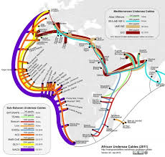
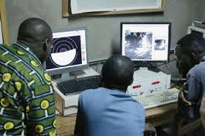
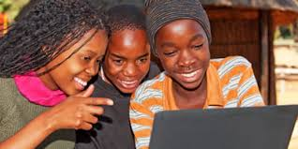
Concepts
Les TIC comme des outils culturels
L’éducation comme un processus socioculturel
Notes:
Several conceptual approaches merit discussion.
ICT
Fist, when we refer to information and communication technologies,
or ICT for short,
we mean computers and internet mainly.
And we relate to them not just as technologies…
But as cultural tools,
being mobilized in specific sociocultural and pedagogical contexts.
And we relate to education as a sociocultural process,
understanding that education is rooted in society
and specific historical and cultural contexts.
Map from https://manypossibilities.net/african-undersea-cables

Slide 6
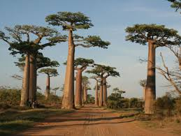
Concepts
L’appropriation
pas la maitrise d’une technologie,
mais l’enracinement de la nouveauté
– dans la personne, la culture –,
la mobilisation stratégique des innovations
pour l’atteint des aspirations bien contextualisées,
en combinant l’ancien et le nouveau,
souvent en résistance au statu quo
Bakhtin, 1981; Fonlon, 2010, 2012; Jouët, 2000; Hountondji, 2002; Lund, 2009; Michiels et Crowder, 2001; Nyamnjoh, Durham et Fokwang, 2002
Notes:
Appropriation
The most important concept we mobilized is that of appropriation,
as a lens through which to understand educators’ use of technology.
L’appropriation n’est pas la maitrise d’une technologie (Jouët, 2000; Lund, 2009),
mais l’enracinement de la nouveauté en soi et dans la société (Bakhtin, 1981; Hountondji, 2002).
C’est la mobilisation stratégique des innovations
afin d’atteindre des aspirations bien contextualisées,
et souvent en résistant le statu quo (Michiels et Crowder, 2001; Surman et Reilly, 2003).
(+Global Knowledge Partnership [GKP], 2002; Nyamnjoh, Durham, & Fokwang, 2002; Toure, 2009)
Tensions play out between habit and innovation as
new is molded and mixed with old (Fonlon, 2010, 2012; Hountondji, 2002).
When educators pedagogically appropriate ICT,
they exert their agency and invest their intentions, beliefs, values and aspirations
in the appropriation process
(Laffey, 2004; Lund, 2009).
They shape ICT and are shaped by it.
The technologies become rooted in their social, economic and cultural realities.
Growing out of sociology, cultural studies, and
communication and media studies beginning in the 1960s (Jouët, 2000),
the concept of appropriation is in contrast to determinism,
which assumes that technology and media determine behavior.

Slide 7
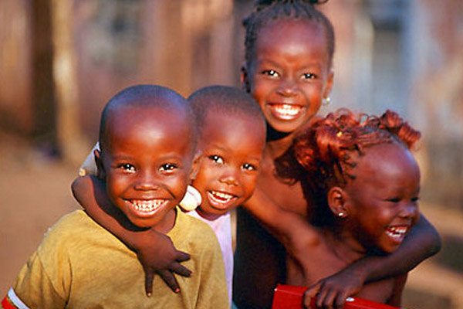
Concepts
Le socioconstructivisme
L’éducation comme processus culturel,
processus de construction,
qui doit aider les jeunes
à découvrir leur potentialités,
à apprendre à utiliser l’esprit
et les outils des cultures du monde
pour comprendre et façonner la société
Bruner, 1996; Obanya, 2014; Tchombe, 2011; Vygotsky, 1978
Notes:
Socio-constructivism
Education is a cultural process,
a constructive process,
that should help young people discover their potentialities
and learn to use their mind and the cultures of the world
to transform society.
This perspective draws on the works of
Vygotsky (Mind is Society, 1978),
Bruner (The Culture of Education, 1996),
Obanya (Educationeering, 2014),
and others (Nasir, 2009; Rogoff, 1995)
who maintain that the mind is not separate from society,
and that learning must be considered in is cultural context.
Tchombe (2011) reference (new to paper):
Tchombe, T. M. S. (2011). Theories of Learning. In T. M. S. Tchombe, and A. B. Nsamenang, Handbook of African Educational Theories and Practices: A Generative Teacher Education Curriculum (pp. 175-193). Bamenda: Human Development Resource Centre.
www.thehdrc.org/Handbook%20of%20African%20Educational%20Theories%20and%20Practices.pdf

Slide 8
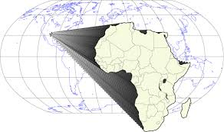
Forces de l’approche conceptuelle
Prise en compte de du génie humain
Place pour les relations de pourvoir, rencontres culturelles, héritages coloniaux
Compréhension du processus de combiner passé et présent de façon créative
Notes:
L’avantage de voir l’utilisation des TIC par les enseignants à travers le concept de l’appropriation est que cette approche prend en compte la mobilisation du génie humaine pour confronter les complexités et les contradictions auxquelles les enseignants font face chaque jour à l’école.
This conceptual lens, of appropriation, accounts for
human ingenuity in confronting complexities and contradictions,
and for the non-linearity of constantly adapting the new
to achieve contextualized needs and aspirations.
Strengths of the conceptual approach
The concept of appropriation serves in the investigation as a lens through which to understand educators’ use of technology, while considering education as a socio-constructive process. Assuming that ICT shapes and is shaped by the contexts in which it is used, this conceptual approach will help research the research objective of understanding, from the perspective of Malian teachers, how and why they pedagogically appropriate information and communication technologies (ICT) and with what perceived changes. The approach accounts for human ingenuity in confronting complexities and contradictions, and for the non-linearity of constantly adapting the new to achieve contextualized needs and aspirations. It encompasses the themes of colonial legacies, learning from cultural encounters, and drawing from past and present to renew culture and create the future, in contexts in which responsibility for the education of youth is a shared one. It draws on African-inspired understandings of appropriation, learning and development. The research is meant to contribute to literature on how humans shape and are shaped by cultural innovations such as ICT.

Slide 9
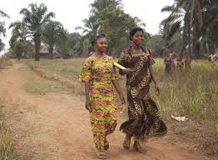
Méthodologie qualitative
Participants
  23 enseignants de l’élémentaire au lycée,
  à Bamako au Mali, 13% femmes,
  tous en train d’utiliser les TIC dans l’éducation
Collecte de données
  entretiens approfondis,
  guide d’entretien
  semi-structuré, transcriptions
Analyse
  interprétation,
  « thick description » (Geertz),
  retour des participants,
  cercles herméneutiques,
  QDA miner
Notes:
Qualitative research methodology
We opted for a qualitative research methodology, rich in explicative power,
because we wanted to better understand the meanings people give to their reality and experiences.
.
Participants
A total of 23 participants were recruited:
19 elementary (grades 1-9) and 4 high school (grades 10-12) teachers.
The teachers worked in six different private and public schools in Bamako, Mali.
13% of the participants were women and 87% men.
All were involved in using ICT in education.
Data collection
We conducted in-depth interviews averaging 1 to 2 hours;
most were individual interviews (18 + 1 interview with the 5 other participants).
We used a semi-structured interview guide,
while also allowing participants to develop aspects of the ICT appropriation process deemed particularly important.
[Interview themes included:
familiarization with ICT,
its use in teaching and learning,
changes if any occurring with the use of ICT, and
reasons for its use]
The interviews with teachers were transcribed.
Data Analysis
We used mainly think description (Geertz, 1973)
which involves
understanding what is shared in context
and interpreting it when describing it.
We sought feedback from participants on the syntheses of their interviews.
We used hermeneutic circles in the interpretation,
circling to and from the whole interview and its parts,
from individual interviews to sets of interviews,
and from interviews to literature that could help us understand what was going on.
We also used QDA miner to code the interviews and their syntheses by theme
[for example familiarization with ICT, changes that seem to occur with the use of ICT in teaching and learning].

Slide 10
Résultats par rapport à comment et pourquoi les enseignants s’approprient les TIC et, selon eux, les changements concomitants
Les TIC s’insèrent
dans la vie quotidienne
Les objectifs pédagogiques guident
les activités d’apprentissage avec les TIC
Des changements sont perçus dans la pédagogie, parmi les étudiants et enseignants, dans le contenu des cours, les salles de classe, les écoles, et le développement professionnel des enseignants
Notes:
The research Objective was to
understand how and why primary and high school teachers in Bamako, Mali
appropriate ICT in teaching and learning,
and, according to them, what changes occur in the process
Familiarization with ICT
The 23 teachers interviewed were first exposed to ICT through personal or professional contacts
or during formal training at university, workshops, or private courses.
The first encounter with ICT was self-motivated or encouraged by the academic hierarchy.
After several months or years, ICT became part of their daily lives.
Click to examples
Use in teaching and learning
In using ICT in teaching and learning, teachers were guided by their pedagogical goals and objectives.
They designed various learning activities using ICT, in relation to those goals and objectives.
Goals included:
share a love for learning, help students discover their hidden talents, inspire responsible leadership in students.
Learning activities using ICT included:
students going to cybercafés to conduct thematic research in groups and reporting on it in class
producing and sharing PowerPoint presentations or videos with schoolchildren in other countries
recording elders sharing about local geography and typing up a synthesis of interviews.
Click to examples.
Teachers’ perceived changes with the use of ICT,
changes among students and teachers, in course content,
in classrooms and schools, and in teachers’ professional development
Click to examples.

Slide 11
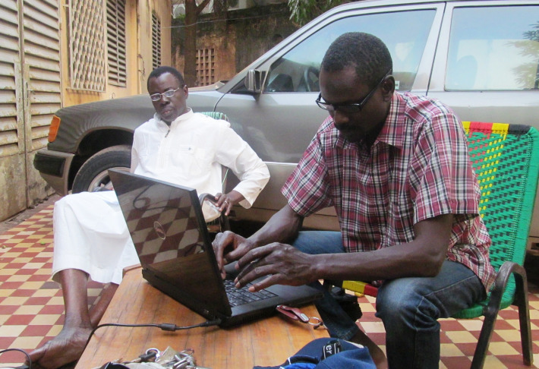
Les TIC dans la vie quotidienne
« Les TIC étaient étranges mais sont devenues intimes ». (Jeremiah)
« La technologie est carrément liée à ma personne ». (Hamidou)
Retourner aux résultats

Slide 12
Les objectifs pédagogiques guident les activités d’apprentissage avec les TIC
Teacher |  | Pedagogical goal or objective | Learning activity using ICT
using ICT to interact with others – to appreciate culture and learn to speak foreign languages
Hamidou | ensure students learn to speak, and not just write, English |  | sharing and learning relationships, via internet, with students in other countries
using ICT to search the Web for information – to learn lifelong learning skills and deepen class discussion
Dramane | active participation in learning economics |  | web searches for material to present in class, for example related to the 2008 financial crisis
Alassane | prepare students for university and equip them with methods for lifelong learning; update outdated lessons, from before Africa’s independence |  | in small groups students search Web on topics such as L’aide au Mali, Malian family code, geography of Russia, Japan or the Americas; teacher evaluates substance of group presentations and quality of interaction with internet
Lassana | nurture in students an understanding and appreciation of African literature |  | surf Web to learn about Senegalese novelist Mariama Bâ and contribute to class discussion before reading her work
Xavier | prepare students for responsible leadership |  | discuss, in classroom and courtyard, speeches downloaded from Web of Barack Obama and others
using ICT to search Web for new teaching methods – to enhance student learning
Ibrahima | in math, help students perform division more successfully |  | less reliance on mental subtraction when doing division (a method teacher learned from Web)
using ICT to produce and share information – to update the curriculum with recent and African content
*Ibrahima | in local geography, fill gaps in 5th grade course |  | students recorded interviews with elders in nearby neighborhoods, organized the information collected and typed it up for future use
Retourner aux résultats

Slide 13
Des changements parviennent avec l’utilisation pédagogique des TIC, selon les enseignants
Perceived changes with the use of ICT
in pedagogy | More active and interactive approaches, in which students are involved and considered and teachers guide students in learning to learn. See Ibrahima and Bintou
among students | More visible and vocal. Motivated to speak, ask questions and be active and engaged in their learning.
among teachers | Motivated by the use of ICT and energized. Humbler about what they know and know that they must keep learning.
in course content | Less monotonous, less stagnant. Courses enriched and updated. Locally available knowledge may be revalorized as it too is interrogated and integrated. See Dramane
in classrooms | Less rigid, more fluid. More dialogue and diverse voices and perspectives. More student initiative and participation and more power sharing.
at school | School life transcends boundaries. More open to community and world and vice versa. New spaces such as computer labs bring new opportunities. School culture can be refreshed and reinvigorated.
in teachers’ professional development | Internet becomes a companion for teachers in deepening their knowledge and evolving their pedagogies. See Xavier
Continuer au Discussion

Slide 14
Changements pédagogiques perçus avec l’utilisation des TIC
« A l’époque, le maitre dispensait les cours… maintenant on partage les idées, l’élève ne conçoit pas seulement ce que je dis ». (Ibrahima)
« Je ne fais plus les croquis au tableau; je m’étale plus sur les leçons qu’auparavant, ce qui facilite la compréhension ». (Bintou)
Retourner au Tableau de changements

Slide 15
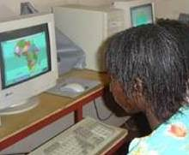
Changements dans le contenu des cours perçus avec l’utilisation des TIC
« Au lieu de dessiner au tableau, dans la salle informatique, on compare les différentes cartes d’Afrique. Et on accède aux infos sur la crise financière de 2008 – qui n’est pas couverte dans les manuels scolaires ». (Dramane)
Retourner au Tableau de changements

Slide 16
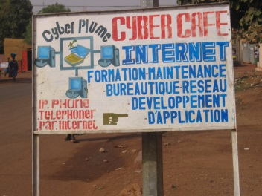
Changements perçus dans le développement professionnel des enseignants
« J’ai envoyé un courriel à un ami au Bénin pour lui demander English for Africa. Il se trouve qu’il ne l’utilise pas, et moi je croyais qu’on utilisait ce livre partout en Afrique ». (Xavier)
Retourner au Tableau de changements

Slide 17
Discussion
Enseignants attirés par les possibilités transformatives des TIC
Utilisation des TIC par rapport aux objectifs pédagogiques, aspirations de société
Tensions entre tradition et nouveauté
Le processus d’appropriation pédagogique des TIC semble catalyser l’apprentissage actif et socio-constructif
Enseignants en train d’arrimer leur culture et leurs nouveaux outils pour créer l’avenir
Notes:
Discussion
The appropriation process, as described by the 23 teachers in Bamako, Mali,
seemed to some extent to be
a catalyst for active and socio-constructive education and learning (Bruner, 1996; Obanya, 2012a, 2014).
The teachers took risks, challenged the status quo,
crossed borders, and worked with students and others
to engage in new encounters and to synthesize information in new ways.
The appropriation process was complex and ambiguous:
tensions arose in the face of something new and unknown,
between the comfort of familiarity and the uneasiness of novelty,
between preservation and transformation of traditional practices,
between the linearity of classical teaching and the fluidity of more dialogical learning.
The teachers were actively envisioning the future
and tentatively shaping the way technology is integrated into learning
in some classrooms and schools in Bamako.

Slide 18
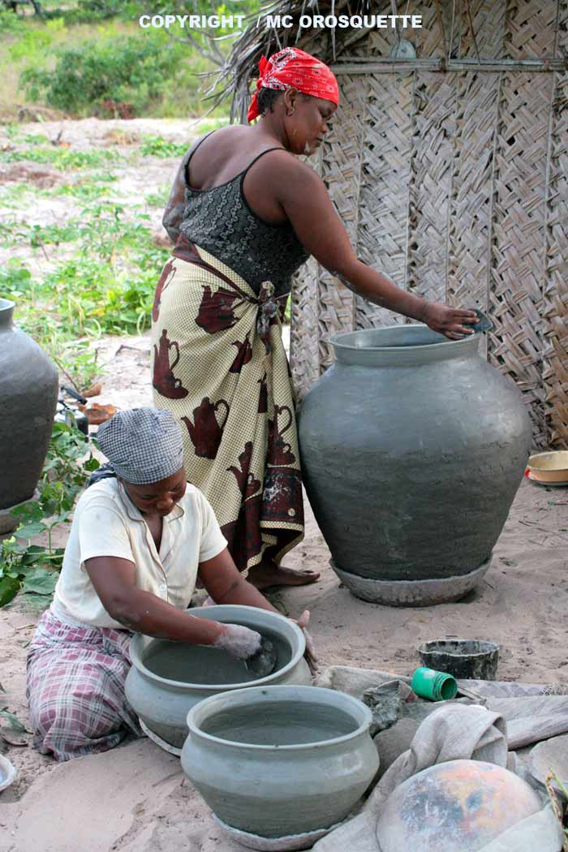
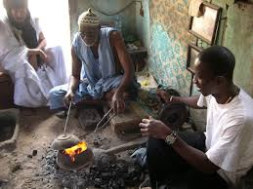
Les enseignants, interviewés à Bamako au Mali, perçoivent les besoins pédagogiques, rêvent de l’avenir, et façonnent l’utilisation des TIC en conséquence.
Sont-ils et elles comme les potiers et forgeons d’Afrique… en train d’écouter, de discerner les besoins de la société, et, avec leurs outils, de fabriquer en conséquence?
Notes:
Photo des femmes: www.colorsofwildlife.net/forum/index.php?topic=578.0
Photo des hommes: "forgerons-bijoutiers" de Mauritanie, www.usinages.com/threads/realisation-dun-bronze-a-la-cire-perdue.23392/page-2

Slide 19
Conclusion
L’appropriation pédagogique des TIC est un processus social et culturel
L’enseignant adapte très activement les TIC à son environnement
Le processus semble introduire des changements : enseignement plus interactif, salles de classes et écoles plus ouverts
Suggérant que les TIC peuvent catalyser un renouvellement pédagogique
Notes:
Frustrated with monotony and the status quo and envisioning a different tomorrow, teachers used ICT to infuse new flexibilities into learning. ICT became an ally for them in negotiating changing times and awakening and nourishing their potentialities and those of their students – and those of various cultures. Whether the impetus for the appropriation of ICT was internal (initiated by the teacher) or external (encouraged by the school administration) or both, the teachers interviewed harnessed ICT because of the transformative possibilities of its use or simply to remain qualified to teach. Our supposition about the transformative nature of the pedagogical appropriation of ICT was confirmed, suggesting that ICT use can be a catalyst for pedagogical change especially in a context that has been locked into a colonial educational system and where access to documentation has been difficult.
More about HOW:
In pedagogically appropriating ICT, teachers navigated and persevered through tensions between old and new, conservation and change, the linearity of conventional teaching and the fluidity of dialogical learning. They brought their hopes and fears, their frustrations and hesitations, and their imaginations, intuition and initiative to bear as they straddled different ways of knowing and being and doing, gradually working toward synthesis between tradition and novelty in themselves and their classrooms.

Slide 20
Quelques limites
Perceptions des enseignants
…mais leurs perspectives sont aussi une force
Nombre de participants (23) limite les possibilités de la généralisation
…mais pas de la généralisation naturaliste
Participants assez enthousiastes par rapport aux TIC …études avec des participants moins ouverts au
changement peuvent donner différents résultats
Enseignants et écoles d’un centre urbain
Notes:
1. Results drawn from what teachers shared in interviews.
Their perceptions
of what is happening with the pedagogical appropriation of ICT
are not confirmed
via formal interviews with others or formal classroom observation.
2. Small number of participants (23), so findings not generalizable
(but possibilities of naturalistic generalization are not excluded)
3. Participants were fairly enthusiastic about ICT and open to change.
Similar studies of teachers less open to change could provide different results.
4. Educators emanated from urban centers and there was a preponderance of teachers from private schools.
Additional studies are required to understand the specificities of the pedagogical appropriation of ICT more generally
in urban and rural settings and in public and private schools in West Africa.

Slide 21
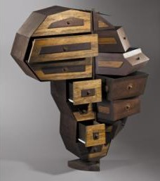
Recommandations
Études futures
milieux péri-urbains et ruraux
accès à internet sur les mobiles
Politiques
s’inspirer de l’expérience, de la praxis, des enseignants
Notes:
Alassane Drabo : Cadre d’union (Burkina Faso), 2005
Bois et métal. H. : 157 cm
Collection de la Biennale d’art africain contemporain, Dakar.
Exposé dans "Design en Afrique" au musée Dapper, Paris.
ARCHIVES MUSÉE DAPPER ET DOMINIQUE COHAS
http://provincedelequateur.blogspot.com/2012/10/le-nouveau-design-et-la-culture-en.html
Strengths and Contributions of the Research
We provided insights into the process of harnessing ICT
to pedagogical and other goals in West Africa.
2. We linked the findings with literature
from sociology
(Do-Nascimento, 2005; Jouët, 2000; Nyamnjoh, Durham, & Fokwang, 2002; Nyamnjoh & Shoro, 2011; Surman & Reilly, 2003).
and cultural psychology
(Vygotsky (1978), Bruner (1969) and Obanya (2011, 2012a, 2012b, 2014).
3. The work was rich in inspiration from African scholars.
4. We evoked epistemological dilemmas,
such as the relevance of education and very reasons
for the integration of ICT in education.
[When some researchers focus only on practical dilemmas
such as high teacher-student ratios and lack of teaching and learning materials].
5. We were able to meaningfully mobilize the concept of appropriation
in educational contexts in West Africa.
6. The qualitative research methodology
(Bernard, 2006; Karsenti & Savoie-Zajc, 2011; Thomas, 2013; Wertz et al., 2011)
allowed research participants
to explain their actions and beliefs in their own words (Haddon, 2000).
7. The perspectives of teachers,
which are often neglected or discounted,
were brought to the fore,
revealing some of the questions and challenges with which they grapple
in coming to terms with informational and technological revolution.
8. Through a holistic approach to formal education,
we showed that educators,
whether working in primary and high schools or at the university level,
are acting on desires to use ICT in transformative ways.
9. Finally, we upset stereotypes
of culture as stagnant or frozen, and
of Africans as recipients rather than shapers of identities and futures.

Slide 22
Acknowledgements / Remerciements
Nia Kadidia Diallo ● Daouda Cissé ● Dramane Darave ● Kafui Dansou ● Denis Dougnon ● Moussa Diarra ● Moussa Dramé ● Gabriel Dumouchel ● Gabriel Yandjou ● Normand Roy ● Aurélien Fievez ● Sophie Goyer ● Pier-Philippe Chevigny ● Deborah Glassman ● Joan Sarno ● Suzan Hampton ● Jean-Michel + Gisèle Labatut ● Rohinton Medhora ● Angela Arnott ● Francois-Joseph Azoh ● Connie Freeman ● Nafissatou Diallo ● Nicole Genereux ● Yaro Yacouba ● Amitav Rath ● Dudley Andrew ● Catherine Daffé ● Carole Joubert ● Mohamed Maïga ● Francis Nyamnjoh ● Nadine Sanoh ● Maria Diallo ● Debbie Fredo ● Bréhima Tounkara ● Augustin Niango ● Aya + Patrick +Soutcho Touré ● Pénangnini Touré ● Frédérique Weyer ● Michel Carton ● Johnson Country Community College ● Woodneath Library Center ● IDRC/CRDI ● Educational Research Network for West and Central Africa (ERNWACA/ROCARE) ● Pierre Fonkoua ● Therese Tchombe ● Hamidou Naparé ● Cheick Oumar Fomba ● Mireille Massouka ● Mamadou Lamine Diarra ● Adwoa Agyeman ● Natalia Kanem ● Renée Osté-Coulibaly ● Inga Schwarzkopf ● Jael Silliman ● Koura Diallo ● Mamadou Kani Konaté ● Pai Obanya ● Kim Claire Umutesi ● Jessica Icyeza ● Yacouba + Micheline Senyana Diallo ● Mamadou Ndoye ● Mary + Jerome Tajchman ● membres du cohort PhD ● Professeurs Michel Lepage, Colette Gervais, Thierry Karsenti

