Slide 1


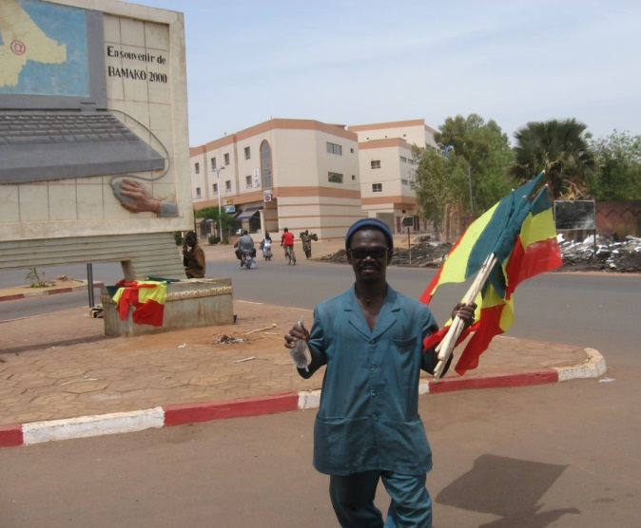
Pedagogical Appropriation of
Information and Communication Technologies by West African Educators
Thèse présentée à la
Faculté des études supérieures et postdoctorales,
Université de Montréal, Québec, Canada,
en vue de l’obtention du grade de PhD (doctorat) en
Sciences de l’éducation, option techno pédagogie
27 août 2015
Kathryn Touré
kathryn.toure@gmail.com
Notes:
I look forward to sharing with you this morning the results of my thesis research
on the pedagogical appropriation of information and communication technologies by West African educators.
I will be speaking in English, but I look forward to your questions in either French or English.
Avec votre permission, je vais présenter en anglais, mais j’attends vos questions en français et an anglais.

Slide 2
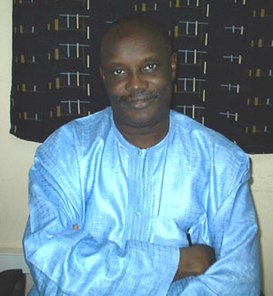
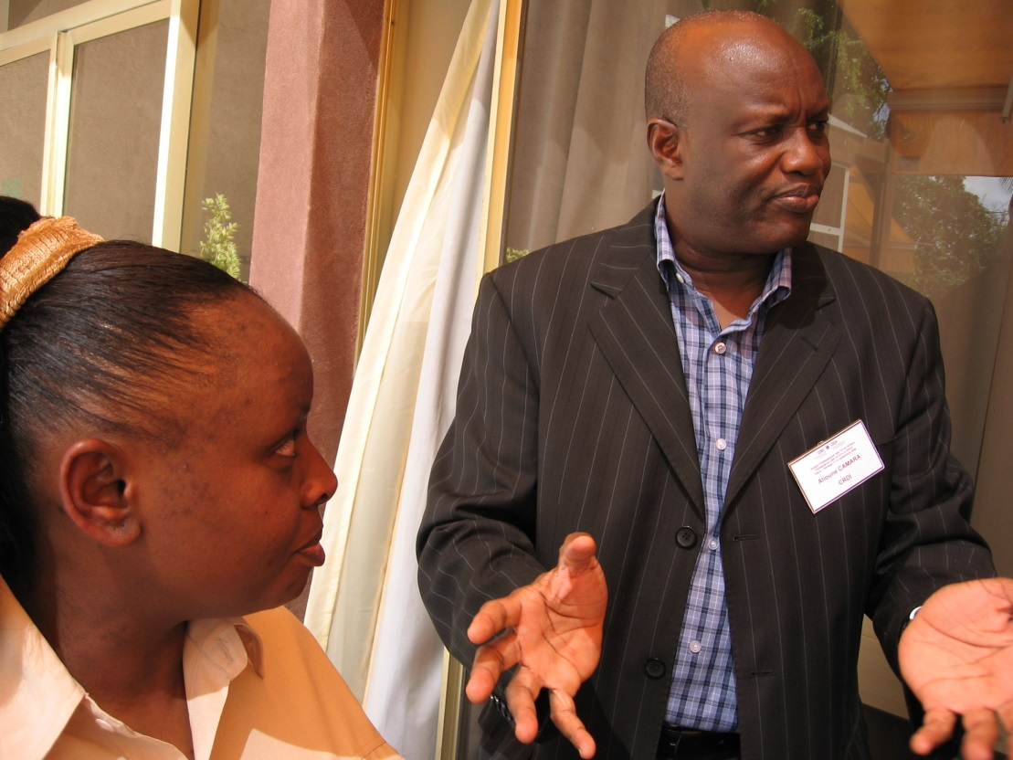
Travail dédié à
Alioune Badara Camara
1951 - 26 août 2014
Notes:
I have dedicated this work to Alioune Badara Camara,
who is in part responsible for my interest in the questions researched.
May his soul rest in peace.

Slide 3
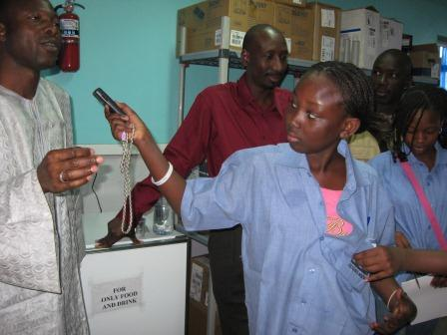
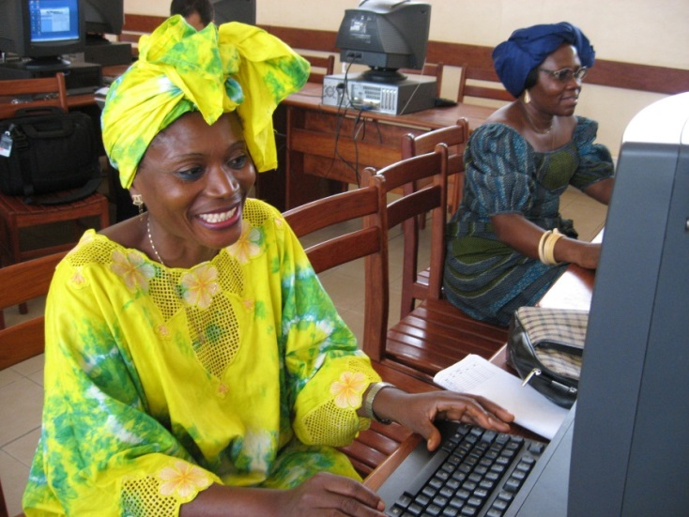
Outline of Presentation
Context and problem
Research objective
Concepts
Methodology
Findings
Conclusion
Notes:
The outline of my presentation is rather standard.
I begin with the context and the problem,
and then present the research objective,
before explaining concepts mobilized and the research methodology used.
I will then spend the most of the time presenting the research findings before concluding.

Slide 4
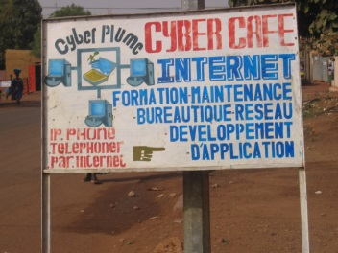
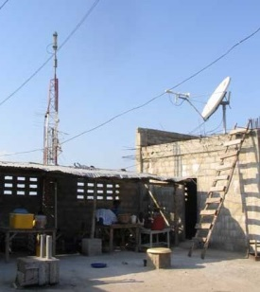
Context and problem
Education in Africa
Indigenous and foreign influences
Pedagogies for the times
Flexible pedagogies that facilitate
remixing of cultures and identities
Proliferation of ICT
Internet connectivity, use of ICT in teaching
Promise of ICT?
For pedagogical renewal?
To promote African cultures?
Notes:
Education in Africa
Education in Africa today
is the result of centuries of cultural encounters.
In indigenous African education,
school and life were one.
With an entire community responsible for teaching children,
through observation, storytelling
and engagement with everyday life (Moumouni, 1964/1998; Nsamenang, 1992).
In the 1100s, madrassas were introduced for the study of the Koran,
and today in Mali madrassas account for 17% of grade 1 through 9 schools.
In the 19th century, French colonists in West Africa
put in place formal education
to train Africans for the colonial administration.
African cultural initiative and imagination were suppressed (Fonlon, 2012; Nyamnjoh, 2004; SAC, 1965).
Learners experienced – and continue to experience – alienation and dualism.
Pedagogies for the times
In this context of disconnect between schools and their milieus,
and the devalorization of African cultures and values, African scholars (Dei, 2002a&b; Fonlon, 2012;)
call for a renewal of school culture,
ones in which pedagogies are informed by African peoples (SAC, 1965).
Needed are flexible pedagogies that facilitate opportunities to rethink and remix cultures and identities.
According to Prof. Fonkoua (2006, p. 233):
Information and communication technologies or ICT
hold promise for the development of pedagogies that are
flexible and adaptable and account for complexity and plurality.
In reading such scholars,
I became more interested in the proliferation of ICT in Africa.
Proliferation of ICT
By 2001, most African countries were connected to internet.
Karsenti & Tchaméni-Ngamo estimated in 2007
that 17% of West and Central African teachers
were already using ICT at school to teach their subjects.
The African Union (2014) encourages the integration of ICT into teaching and learning,
not only to participate in the knowledge economy but also to
“disseminate and promote African cultures across the world” (p. 18).
Promise of ICT?
In this context of the proliferation of ICT in Africa,
its use in teaching,
and
promises of ICT in relation to pedagogical renewal
and the promotion of African cultures,
I became curious about how and why teachers were actually using ICT.
And this curiosity led to…

Slide 5
Research Objective
Understand how and why
West African educators
pedagogically appropriate
information and communication
technologies (ICT)
and with what perceived effects
??
Notes:
The overall research objective was
to understand how and why West African educators pedagogically appropriate ICT,
and with what perceived effects,
for example on their teaching styles.

Slide 6
Specifically related to
Primary and high school teachers in Bamako, Mali
Teachers’ conversations about ICT
Why university professors appropriate ICT
??

Slide 7
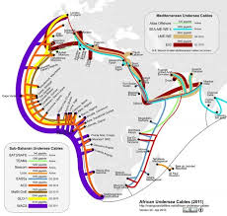
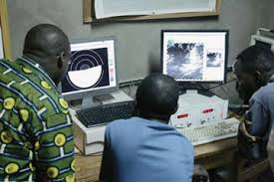
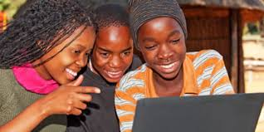
Main concepts
ICT as cultural tools
Sociocultural perspective to account for education as rooted in society and specific historical and cultural contexts
Appropriation
Integrating newness, making innovations responsive to contextualized needs and aspirations, unpacking technologies
within the host culture and rooting them,
making them part and parcel of the social fabric
Notes:
Several conceptual approaches merit discussion.
ICT
Fist, when we refer to information and communication technologies
or ICT for short,
we mean computers and internet mainly.
And we relate to them not just as technologies,
But as cultural tools,
being mobilized in specific sociocultural and pedagogical contexts.
Sociocultural perspective
And we relate to education as a sociocultural process,
understanding that education is rooted in society
and specific historical and cultural contexts.
This perspective draws on the works of
Vygotsky (Mind is Society, 1978),
Bruner (The Culture of Education, 1996),
Obanya (Educationeering, 2014),
and others (Nasir, 2009; Rogoff, 1995)
who maintain that the mind is not separate from society,
and that learning must be considered in is cultural context.
Appropriation
The most important concept we mobilized is that of appropriation,
as a lens through which to understand educators’ use of technology.
Appropriation involves integrating newness into one’s very being and one’s culture
and mobilizing it strategically to meet contextualized objectives,
often in resistance to the status quo
(Bakhtin, 1981; Global Knowledge Partnership [GKP], 2002; Jouët, 2000; Lund, 2009; Michiels & Crowder, 2001; Nyamnjoh, Durham, & Fokwang, 2002; Surman & Reilly, 2003; Toure, 2009).
Tensions play out between habit and innovation as
new is molded and mixed with old (Fonlon, 2010, 2012; Hountondji, 2002).
When educators pedagogically appropriate ICT,
they exert their agency and invest their intentions, beliefs, values and aspirations
in the appropriation process
(Laffey, 2004; Lund, 2009).
They shape ICT and are shaped by it.
The technologies become rooted in their social, economic and cultural realities.
Growing out of sociology, cultural studies, and
communication and media studies beginning in the 1960s (Jouët, 2000),
the concept of appropriation is in contrast to determinism,
which assumes that technology and media determine behavior.
This conceptual lens, of appropriation, accounts for
human ingenuity in confronting complexities and contradictions,
and for the non-linearity of constantly adapting the new
to achieve contextualized needs and aspirations.
Map from https://manypossibilities.net/african-undersea-cables

Slide 8
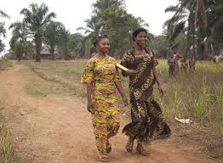
Qualitative research methodology
Participants
31 participants: 13% women and 87% men,
all involved in the use of ICT in education
Data collection
In-depth interviews,
semi-structured interview guide,
transcriptions
Data analysis
Thick description (Geertz),
feedback from participants,
hermeneutic circles, QDA miner
Notes:
Qualitative research methodology
We opted for a qualitative research methodology, rich in explicative power,
because we wanted to better understand the meanings people give to their reality and experiences.
.
Participants
A total of 31 participants were recruited,
including 2 administrators and 23 primary and high school teachers in Bamako, Mali as well a
6 university professors.
13% of the participants were women and 87% men.
All were involved in using ICT in education.
Data collection
We conducted in-depth interviews averaging 1 to 2 hours;
most were individual interviews (24 + 1 interview with the 5 other participants).
We used a semi-structured interview guide,
while also allowing participants to develop aspects of the ICT appropriation process deemed particularly important.
[Interview themes included:
familiarization with ICT,
its use in teaching and learning,
changes if any occurring with the use of ICT, and
reasons for its use]
The interviews with teachers and administrators were transcribed.
Data Analysis
We used mainly think description (Geertz, 1973)
which involves
understanding what is shared in context
and interpreting it when describing it.
We sought feedback from participants on the syntheses of their interviews.
We used hermeneutic circles in the interpretation,
circling to and from the whole interview and its parts,
from individual interviews to sets of interviews,
and from interviews to literature that could help us understand what was going on.
We also used QDA miner to code the interviews and their syntheses by theme
[for example familiarization with ICT, changes that seem to occur with the use of ICT in teaching and learning].

Slide 9
Result in three parts
Primary and high school teachers in Bamako, Mali
Teachers’ conversations about ICT
Why university professors appropriate ICT
??
Notes:
For the presentation of the results,
I will present them in relation to the three specific research objectives
that we reviewed earlier.
The first two concern primary and high school teachers in Bamako, Mali,
and the third relates to university professors
in four different African countries.

Slide 10
Results (1) regarding how and why primary through high school teachers in Mali pedagogically appropriate ICT and, according to them, changes that seem to occur in the process
Familiarization with ICT
Learning ICT until it
meshes into every day life
Use in teaching and learning
Pedagogical goals guided
learning activities using ICT
Changes
Changes perceived in pedagogy,
among students and teachers, in course content,
in classrooms and schools,
and in teachers’ professional development
Notes:
The first specific research Objective was to
understand how and why primary through high school teachers in Bamako, Mali
appropriate ICT in teaching and learning,
and, according to them, what changes occur in the process
Familiarization with ICT
The 23 teachers interviewed were first exposed to ICT through personal or professional contacts
or during formal training at university, workshops, or private courses.
The first encounter with ICT was self-motivated or encouraged by the academic hierarchy.
After several months or years, ICT became part of their daily lives.
Use in teaching and learning
In using ICT in teaching and learning, teachers were guided by their pedagogical goals and objectives.
They designed various learning activities using ICT, in relation to those goals and objectives.
Goals included:
share a love for learning, help students discover their hidden talents, inspire responsible leadership in students.
Learning activities using ICT included:
students going to cybercafés to conduct thematic research in groups and reporting on it in class
producing and sharing PowerPoint presentations or videos with schoolchildren in other countries
recording elders sharing about local geography and typing up a synthesis of interviews.
Click to examples.
Teachers’ perceived changes with the use of ICT,
changes among students and teachers, in course content,
in classrooms and schools, and in teachers’ professional development
Click to examples.

Slide 11
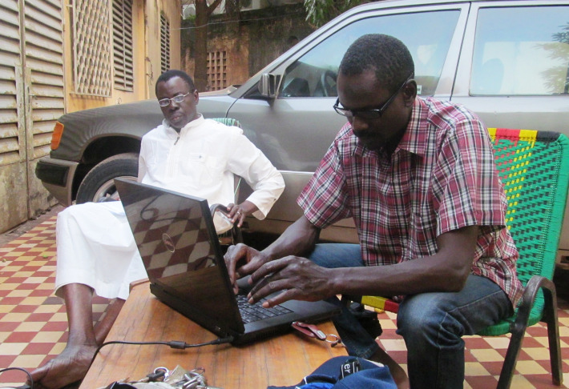
ICT meshes into everyday life
“Les TIC étaient étranges mais sont devenues intimes.” (Jeremiah)
“La technologie est carrément liée à ma personne.” (Hamidou)
Return to Results (1)

Slide 12
from Table 6. Examples of Learning Activities Using ICT, in Relation to Pedagogical Goals and Objectives
Teacher |  | Pedagogical goal or objective | Learning activity using ICT
using ICT to interact with others – to appreciate culture and learn to speak foreign languages
Hamidou | ensure students learn to speak, and not just write, English |  | sharing and learning relationships, via internet, with students in other countries
using ICT to search the Web for information – to learn lifelong learning skills and deepen class discussion
Dramane | active participation in learning economics |  | web searches for material to present in class, for example related to the 2008 financial crisis
Alassane | prepare students for university and equip them with methods for lifelong learning; update outdated lessons, from before Africa’s independence |  | in small groups students search Web on topics such as L’aide au Mali, Malian family code, geography of Russia, Japan or the Americas; teacher evaluates substance of group presentations and quality of interaction with internet
Lassana | nurture in students an understanding and appreciation of African literature |  | surf Web to learn about Senegalese novelist Mariama Bâ and contribute to class discussion before reading her work
Xavier | prepare students for responsible leadership |  | discuss, in classroom and courtyard, speeches downloaded from Web of Barack Obama and others
using ICT to search Web for new teaching methods – to enhance student learning
Ibrahima | in math, help students perform division more successfully |  | less reliance on mental subtraction when doing division (a method teacher learned from Web)
using ICT to produce and share information – to update the curriculum with recent and African content
*Ibrahima | in local geography, fill gaps in 5th grade course |  | students recorded interviews with elders in nearby neighborhoods, organized the information collected and typed it up for future use
Return to Results (1)

Slide 13
from Table 15.
Perceived changes with the use of ICT
in pedagogy | More active and interactive approaches, in which students are involved and considered and teachers guide students in learning to learn. See Ibrahima and Bintou
among students | More visible and vocal. Motivated to speak, ask questions and be active and engaged in their learning.
among teachers | Motivated by the use of ICT and energized. Humbler about what they know and know that they must keep learning.
in course content | Less monotonous, less stagnant. Courses enriched and updated. Locally available knowledge may be revalorized as it too is interrogated and integrated. See Dramane
in classrooms | Less rigid, more fluid. More dialogue and diverse voices and perspectives. More student initiative and participation and more power sharing.
at school | School life transcends boundaries. More open to community and world and vice versa. New spaces such as computer labs bring new opportunities. School culture can be refreshed and reinvigorated.
in teachers’ professional development | Internet becomes a companion for teachers in deepening their knowledge and evolving their pedagogies. See Xavier
Continue to Discussion and Conclusion for Results (1)

Slide 14
Regarding perceived changes in pedagogy with the use ICT
“A l’époque, le maitre dispensait les cours… maintenant on partage les idées, l’élève ne conçoit pas seulement ce que je dis.” (Ibrahima)
“Je ne fais plus les croquis au tableau; je m’étale plus sur les leçons qu’auparavant, ce qui facilite la compréhension.” (Bintou)
Return to Table 15

Slide 15
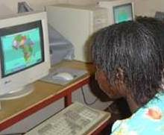
Regarding perceived changes in course content with the use ICT
“Au lieu de dessiner au tableau, dans la salle informatique, on peut comparer les différentes cartes d’Afrique.
“ On peut accéder les infos sur la crise financière de 2008 – qui n’est pas couverte dans les manuels scolaires.” (Dramane)
Return to Table 15

Slide 16
Results (1) regarding how and why primary through high school teachers in Mali pedagogically appropriate ICT and, according to them, changes that seem to occur in the process
Discussion and Conclusion
Tensions arise in the negotiation of tradition and novelty –
as described by theorists of appropriation processes.
Newness is created.
Teachers embraced ICT in relation to pedagogical goals
and for its transformative possibilities.
The appropriation process seemed to catalyze
active and socio-constructive learning.
Teachers were envisioning the future and tentatively
shaping the integration of technology
into learning in some classrooms and schools in Bamako.
Notes:
Discussion and conclusion
The appropriation process, as described by the 23 teachers in Bamako, Mali,
seemed to some extent to be
a catalyst for active and socio-constructive education and learning (Bruner, 1996; Obanya, 2012a, 2014).
The teachers took risks, challenged the status quo,
crossed borders, and worked with students and others
to engage in new encounters and to synthesize information in new ways.
The appropriation process was complex and ambiguous:
tensions arose in the face of something new and unknown,
between the comfort of familiarity and the uneasiness of novelty,
between preservation and transformation of traditional practices,
between the linearity of classical teaching and the fluidity of more dialogical learning.
The teachers were actively envisioning the future
and tentatively shaping the way technology is integrated into learning
in some classrooms and schools in Bamako.

Slide 17
Results (2) regarding teachers’ conversations with others, about the use of ICT in teaching and learning
Results
Teachers’ conversations with various social actors:
peers, school and district directors, pedagogical advisors,
parents, other community members
Discussion and conclusion
Teachers as border pedagogues and cultural workers,
engaging others in collectively shaping ICT,
ICT as a catalyst for the renewal of school culture
Continue to Results (3)
Notes:
The second specific research objective was to understand the role of teachers’ conversations with others,
about the use of ICT in teaching and learning, in the pedagogical appropriation of ICT.
[Complimentary concepts
We brought in complimentary concepts to help us in our understanding, that of “culture as conversation” and of “continuous conversations at borders as contributing to cultural transformation.
- Philosophers Hassoun and Wong (2012) view culture as a “living, changing thing” (p. 86) and conceive of
culture as conversation and as sustained through conversations. This conception acknowledges the internal contestation, diversity and fluidity of culture, as well as the agency and participation of a culture’s members in transmitting, interpreting and revising their culture.
“The plural voices in a conversation bring […] the possibility of change, especially when the voices are disagreeing” and challenging each other (p. 77). - - Continuous conversations at borders are particularly likely to contribute to cultural transformation; by borders we mean places where different social worlds intersect (Akkerman & Bakker, 2011). Such boundaries as conceptualized in educational theory are considered as a challenge and as a resource for learning and developing new understanding and practices (Akkerman & Bakker, 2011).
Transformation begins with confrontation that disrupts “the current flow of work” (p. 147).
And insufficient continuous “work at the boundary could explain the lack of […] lasting transformations” (Akkerman & Bakker, 2011, p. 149).
[- Ela (2006): Just as those that possess indigenous knowledge need to learn about other knowledge and about new tools for forging into the prevailing world of science and technology, the young need to return to old people and their wisdom to reconnect with their scientific memory. (p. 400, our translation)]
Results
Teachers engaged in conversations with various social actors:
namely peers, school and district directors, pedagogical advisors,
parents, other community members
Let’s take a look at the nature of those conversations.
Click to table. Click to next table.
Discussion
According to what we heard from teachers,
they do not appropriate ICT in the classroom independently of others’ views and perspectives;
they engage others as they shape how ICT is used at school,
because they live and work in an environment
where children belong to the community and their education is of concern to all.
ICT use provides an opening.
It disrupts the flow of routines (Akkerman & Bakker, 2011) and introduces new information and concepts.
In engaging with it and conversing about it, teachers and others
look anew at learning and relations with knowledge and culture,
and relations of power – in the classroom and beyond.
ICT brings multiple social worlds into more intimate contact with each other,
which becomes an occasion for rethinking sources of knowledge and ways of knowing.
Teachers are not using ICT to flee their cultures
but to enter into them in creative and challenging ways
and free up the curriculum to grow more relevant for their students and communities.
Teachers engaging in conversations with others about the use of ICT in education were border pedagogues and cultural workers.
Conclusion
Teachers’ conversations in Bamako
about the use of ICT in education
are part of the process of involving various social actors
in deciding how ICT will be used
and how school culture might be renewed.
ICT can be a catalyst for the renewal of school culture,
to the degree that these new tools, and the changes they bring,
become the object of public curiosity and contestation.
Many of the teachers we interviewed are
actively facilitating social dialogue
about ICT and its place in education.
In so doing they are involved in
challenging established hierarchies, rethinking knowledge and school, and proposing new options.
ICT is an opportunity, in the Malian school context,
to dialogue fruitfully across boundaries
in the interest of collective rethinking and reworking of school culture.
Through their use of ICT, teachers bring the world to Mali and Malian culture to bear on its appropriation.

Slide 18
from Tables in section 6.4 – Teachers’ conversations with (or about) various social actors, regarding the use of ICT in teaching and learning (part 1)
Social Actors
Nature of conversations | Examples
Peers
Mutual support and complicity | Pedagogical committees at Hamidou’s school became a source of support for teaching learning and experimenting ICT and persisting through difficulties.
Frustration and impatience | Teachers express impatience with peers “caught in a rut,” who do not “muster the courage” (Hamidou) to move beyond their comfort zone, to learn how to browse, to update their courses.
School and District Advisors
Engaging with school directors | Xavier, unable to persuade his director about new pedagogical approaches his use of ICT implies, for example putting students into groups, explains, “The director does not understand why I do that. Schools directors can help us if they listen to us.”
Advising district director | Sensing the necessity for school directors to understand ICT, Jeremiah met with the Academy director to suggest he require directors’ annual reports be typewritten – as a way to motivate them to learn and use ICT.
Pedagogical advisors
Advisors learning from teachers | When an advisor asked if what is on internet is credible, Alassane said he replied, “Some is; some is not. You have to know how to navigate… know what you want and how to obtain it.”
Expressing frustration with ongoing dependency | “Only yesterday we received science suitcases from an association in France, containing objects to help in teaching about the human body and the earth. Now if an advisor had a computer, they could do research to prepare lessons.” (Lamine, a supervisor of advisors)
Continue to part 2
Notes:
With peers:
feel their reluctance to embrace ICT hinders the teaching corps and its capacity to shape the education system

Slide 19
from Tables in section 6.4 – Teachers’ conversations with (or about) various social actors, regarding the use of ICT in teaching and learning (part 2)
Social Actor
Nature of conversations | Examples
Parents
Importance of connecting with parents | “As long as we do not explain things, parents do not know the impact or importance of ICT in education” (Alassane). Students and their parents must be involved (Mohamed of the ICT ministry).
Discussing pedagogy | When approached by parents about “playing” in class rather than preparing for exams, Hamidou explained the pertinence of activity and interaction for learning to speak and not just write a foreign language.
Discussing course content | Parents of 5th graders did not object (which Ibrahima interpreted as approval) when they received the document teachers and students prepared on local geography, which incorporated local knowledge from recorded interviews with elders.
People in communities surrounding schools
Synthesis of information from several sources | Issa shares proverbs on the school website, “because of the wisdom in them. I find the proverbs on the Web too universalized, however. That is why I am recording ones shared by elders – to publish and share them.”
 | “In researching the history of the Bacodjikoroni neighborhood in Bamako, I indicated who in the neighborhood students should go see. When they returned, we wrote a synthesis of what they learned and what I found on the Web.” (Alassane)
Culturally embedded attitudes toward newness and change | “Like our griots, the Web gathers and shares information. We consult many people to find a solution to a problem, so also should we consult the Web. We need to encourage the positive sides of it.” (Ibrahima) “The African is obliged to adapt.” (Dramane)
Return to part 1 of table
Return to Results (2)
Notes:
With parents:
dialoguing with inquisitive parents about more active pedagogies

Slide 20
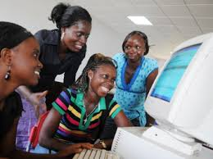
Results (3) regarding why university professors pedagogically appropriate ICT
Methodology
Sociocultural interpretation of
ICT itineraries of six West African professors
Results
3 motivations for ICT appropriation,
linked to past, present and future
Discussion and conclusion
Professors invested their cultures and personalities in the appropriation of ICT,
contributing to African pedagogies and epistemological contexts for the integration of ICT that reflect African aspirations,
for a better integration of Africans into society and into the world
Continue summary of results
Notes:
Introduction
La recherche montre la nécessité de l’éducation d’être façonné par les africains (SAC, 1965)
et des initiatives TIC d’être imprégnées des aspirations des utilisateurs de ces innovations (Anthony et Muliaro, 2008).
Karsenti et Larose (2011, p. 11) s’étale
sur l’importance, dans les pédagogies universitaires, des « postures épistémologiques »
qui servent de contexte à l’intégration des technologies.
Selon Tchombe (2011),
les intellectuels africains doivent assumer un rôle de leadership dans l’éducation, la recherche et
l’utilisation des TIC
et les forger selon une épistémologie africaine.
Objectif
Motivés par ces chercheurs, nous avons essayé de comprendre les raisons pour lesquelles des professeurs de l’enseignement supérieur en Afrique de l’Ouest s’approprient les technologies de l’information et de la communication (TIC).
Méthodologie
Les motivation des professeurs sont abordées à travers une
interprétation socioculturelle d’itinéraires de six professeurs.
Il s’agit de femmes et d’hommes,
de francophones et d’anglophones,
de musulmans et de chrétiens
qui enseignaient les humanités, les sciences humaines, ou les sciences naturelles
dans quatre différents pays ouest-africains.
Ils avaient entre 40 et 55 ans.
Ils ont découvert l’ordinateur, de façon générale, au milieu des années 1980
et l’internet à partir de l’an 2000.
Nous avons développé pour chaque professeur un « itinéraire TIC »
qui relate sa rencontre et son interaction avec les TIC.
Les résultats de recherche sont présentés
sous forme de six itinéraires TIC dans lesquels la personnalité professionnelle de chaque professeur transparaît.
L’approche vise à permettre au lecteur d’entrer dans le vécu des professeurs et de
mieux comprendre leur utilisation des TIC de leur point de vue.
Regardons des extraits de la synthèse, de la conception des TIC, de deux de ces professeurs (Kadijatou et Sidi).
(cliquer)
Résultats
Après la découverte des possibilités pédagogiques des TIC,
les six professeurs interviewés ont persisté dans l’intégration des TIC dans leur enseignement
dans un va-et-vient entre restauration et intégration (Fonlon, 2010),
entre nouveau et ancien.
Nous avons trouvé, à travers les itinéraires TIC des 6 professeurs,
3 motivations pour l’appropriation pédagogique des TIC,
liées respectivement au passé, présent et future.
(cliquer)
Discussion et conclusion
Les parcours des six enseignants ouest-africains du supérieur
montrent que les professeurs investissent,
dans l’appropriation des TIC,
leur expérience, leur personnalité, et leur culture
pour domestiquer les TIC et réaliser leurs aspirations.
C’est ainsi que les TIC trouveront une place utile dans le processus éducatif.
Selon la Société africaine de culture,
une pédagogie africaine se crée
seulement en repensant les innovations
« dans le contexte des possibilités et des exigences locales » (SAC, 1965, p. 8).
Les motivations des six professeurs rencontrés aujourd’hui
peuvent informer les raisons épistémologiques
pour l’intégration des TIC dans l’éducation en Afrique.
Pour ainsi réaliser la vision de Fonlon (2010) qui écrit [lire du livre]
qu’il faut restaurer la culture et les valeurs africaines
pour une meilleure intégration de l’homme et de la femme dans son environnement,
de l’Africain dans la société et dans le monde.
Cependant,
la convivialité et la socialité des Africains (Nyamnjoh, 2015; Piot, 1999),
qui trouvent leur expression dans l’utilisation créative des TIC,
peuvent aussi être annihilées ou tout au moins étouffées
par des systèmes universitaires hautement hiérarchisés
qui privilégient le travail disciplinaire et l’avancement individuel
au détriment du travail transdisciplinaire et collaboratif.

Slide 21
Kadijatou
Avec les TIC Kadijatou peut finir le programme même lors des grèves sur le campus et suivre des étudiants en dehors de la capitale. Les TIC l’aident à préparer les jeunes à obtenir du travail et à contribuer à la nation et au monde scientifique.
Return to Results (3)
Continue to Sidi

Slide 22
Sidi
Sidi voudrait que les Africains utilisent de façon stratégique les TIC pour apprendre, produire des connaissances et réaligner les relations de pouvoir. Selon lui, il faut « se lancer sur la scène des innovations », rénover et défendre la culture africaine.
Return to Kadijatou
Return to Results (3)

Slide 23
from Tables 13 and 17. Professors’ motivations for the pedagogical appropriation of ICT
(Re)create positive learning experiences
Engage with ICT to feel more autonomous in learning, enhance reflection, and learn with others
Facilitate African participation in the world
Strengthen African scholarly production, extend the reach of African ideas and perspectives
Transform relations and cultures
Interrogate heritage and renegotiate knowledge, transform learning, and evolve African identities
Return to Results (3)
Notes:
1.
Trois professeurs souhaitaient utiliser les TIC pour partager avec leurs étudiants des expériences pédagogies positives.
Sidi et Bakri ont bénéficié de séjours de découverte et d’apprentissage à l’étranger, et ils essaient de recréer l’esprit et la richesse de ces rencontres pour leurs étudiants dans l’utilisation d’internet. Kannou voudrait que ses étudiants expérimentent la même autonomie qui a caractérisé ses apprentissages, et il insiste ainsi pour que chaque étudiant obtienne un ordinateur.
2.
Cinq professeurs souhaitaient faciliter la participation africaine dans le monde.
Ils réfléchissent à comment les Africains peuvent laisser leur marque dans la recherche prédominée par la pensée occidentale, et comment les TIC peuvent faciliter plusieurs niveaux de présence et de participation aux débats de société et à la production scientifique. Ils investissent dans leur appropriation pédagogique des TIC leur désir de renforcer les voix africaines dans les échanges locaux et mondiaux, de rendre les Africains, leurs pensées, leurs vision disponibles au monde.
Au lieu de consommer simplement les TIC et être « culturellement pauvres », ils voudraient, avec leurs étudiants, les repenser et les adapter aux besoins du milieu et ainsi enrichir l’enseignement et la culture.
3.
Trois professeurs exprimaient des désires plutôt liées a l’avenir: ils souhaitaient transformer les relations et la culture, avec les TIC.
- Selon Bakri, les TIC peuvent aider à faire de la place, dans l’enseignement et l’apprentissage, pour ce qui était connu mais oublié. Les TIC ouvrent la connaissance et la culture à l’inspection et à l’interrogation, et à une renégociation de ce qui doit y être inclus et comment.
- Sidi recherche, à travers les TIC, la transformation de soi et de l’enseignement, ainsi que la culture.
Isadora songe à l’évolution de la personnalité africaine, qui n’est pas figée dans le temps.

Slide 24
Summary of findings in relation to
1st specific research objective
How and why teachers appropriate ICT, with what changes
Teachers learned ICT through others and used it until it meshed into everyday life, harnessed ICT for its transformative possibilities, deployed it in relation to their pedagogical goals, experienced changes in their teaching (more interactive), classrooms and schools
(more open and dialogical)
Suggesting ICT can be a catalyst for pedagogical change, in contexts weighed down by the legacy of colonialism
Notes:
1.
Teachers described going from thought to action which lead to change – in relations and spaces, in what is taught and how.
Course content was enriched and updated.
Dialogue and diverse perspectives became possible in classrooms that had been lecture halls,
with virtually no back and forth between teachers and students.
Schools opened to knowledge near and far, and
teachers pursued their professional development in newly networked and informal ways.
Thus contributing to the objective of schooling, according to socio-constructivists:
help young people “adapt to the world in which they find themselves and to help in the process of changing it as required” (Bruner, 1996, p. 20);
transform people so they are capable of the “continuous regeneration of Society” (Obanya, 2012a, p. 23).
Teachers leverage ICT creatively and strategically to help refresh school culture – without losing sight of the high-stakes exams their students must take. They make education more responsive to students’ needs, thus more resilient, and more reliant on local and global resources beyond textbooks.
Frustrated with monotony and the status quo and envisioning a different tomorrow, teachers used ICT to infuse new flexibilities into learning. ICT became an ally for them in negotiating changing times and awakening and nourishing their potentialities and those of their students – and those of various cultures. Whether the impetus for the appropriation of ICT was internal (initiated by the teacher) or external (encouraged by the school administration) or both, the teachers interviewed harnessed ICT because of the transformative possibilities of its use or simply to remain qualified to teach. Our supposition about the transformative nature of the pedagogical appropriation of ICT was confirmed, suggesting that ICT use can be a catalyst for pedagogical change especially in a context that has been locked into a colonial educational system and where access to documentation has been difficult.
More about HOW:
In pedagogically appropriating ICT, teachers navigated and persevered through tensions between old and new, conservation and change, the linearity of conventional teaching and the fluidity of dialogical learning. They brought their hopes and fears, their frustrations and hesitations, and their imaginations, intuition and initiative to bear as they straddled different ways of knowing and being and doing, gradually working toward synthesis between tradition and novelty in themselves and their classrooms.

Slide 25
Summary of findings in relation to
2nd specific research objective
Teachers’ conversations about ICT in education
Facilitated social shaping of ICT, in a
spirit of consensus that characterizes their culture,
opening doors to the reconsideration
of local and global cultures and their remixing,
pointing to pathways
for the revitalization of learning
and the renewal of education
Notes:
2.
Reshaping school culture is part of the process of regaining responsibility for cultural initiative and creating a “new, rich, harmonized and dynamic culture” (Fonlon, 2012, p. 91).
The conversations and interactions teachers reported reveal how the pedagogical appropriation of ICT in the context of the teachers interviewed
seems to be a social process, embedded in schools, systems and communities.
[Some teachers seemed content to work out in their classrooms and schools changes that ICT appropriation brings, whereas others seemed particularly committed to ensuring broader participatory discussion about the appropriation of ICT and its use in teaching and learning.]
With others, teachers discuss the risks and the benefits, what Africa has to gain and to contribute in the use of ICT.
Though these teachers use ICT with intentionality and exercise agency,
they are not working on their own but rather
in a spirit of consensus that characterizes their culture.
[They went into communities “with their resources and possibilities” to help create “borderlands for dialogue” about the construction of tomorrow (Giroux, 2005, p. 135).]
Society has a say about how ICT is used (Jenkins, 2009; Surman & Reilly, 2003) in teaching and learning,
and teachers play a role in brokering that dialogue.
They are revitalizing learning by facilitating the selective integration of elements from multiple approaches and cultures (Fonlon, 2012).
At the same time they bring the world to Mali, they bring Malian culture to bear on the appropriation of ICT.

Slide 26
Summary of findings in relation to
3rd specific research objective
Why university professors pedagogically appropriate ICT
Shape their students’ learning experiences,
ensure they participate in the world,
and help position them to
transform relations and culture
Notes:
3.
Deeper aspirations.
The professors expressed desires to shape learning experiences for their students,
ensure as Africans they participate in the world,
and help position them to transform relations and culture.
(a) recreate positive learning experiences,
(b) facilitate African participation in the world, particularly of knowledge, and
(c) transform relations and culture
Accustomed to straddling different ways of knowing and producing knowledge, they felt comfortable bridging between their grandparents who relied mainly on oral tradition and their students whom they expected to know African traditions and also imbibe and influence global cultures increasingly accessible and reachable via ICT.
Putting a course on line and communicating with students by email might seem quite mundane, but those acts challenged established roles of professors and students and relations between them. As social creatures attracted to connecting with others in their process of becoming, they used ICT to enhance contact and sociality.
They could be very present halfway around the world while physically distant, mobile while staying put. They could project their multidimensional selves and other things African, making them perceived and palpable, without having to board a plane.
ICT provided them with new pathways to define themselves and their identities rather than having them defined and limited by others and by limiting notions and practices.
The professors interviewed adapted ICT to their milieu, in relation to educational needs and cultural values and desires to fruitfully engage the past, present and future.

Slide 27
Conclusion
Limits
Diagram of:
Changes evident at multiple levels
Strengths
Notes:
Dear jury members,
in conclusion, I would like to
propose a diagram of changes that seem to be emerging
at multiple levels, with the pedagogical appropriation of ICT.
In viewing the diagram, it may be helpful
to keep in mind some of the limits of the study,
so I will present the limits,
then propose the diagram,
and wrap up by mentioning some of the strengths and contributions of the research.

Slide 28
Some Limits
Small number of participants (31)
Results drawn from teachers’ perceptions
Participants fairly enthusiastic about ICT
Teachers from urban centers, preponderance of private elementary and high schools
Short term of the study
Notes:
LIMITS
1. Small number of participants (31), so findings not generalizable
2. Results drawn from what teachers shared in interviews.
Their perceptions are what is happening with the pedagogical appropriation of ICT
are not confirmed
via formal interviews with others or formal classroom observation.
3. Participants were fairly enthusiastic about ICT and open to change.
Similar studies of teachers less open to change could provide different results.
4. Educators emanated from urban centers and there was a preponderance of teachers from private schools.
Additional studies are required to understand the specificities of the pedagogical appropriation of ICT more generally
in urban and rural settings and in public and private schools in West Africa.
5. This study was rather short term.
A longer-term study could examine more indepthly how
the appropriation of ICT contributes to cultural change (or not).

Slide 29
Changes
and possibilities of change
evident at multiple levels
with the
pedagogical appropriation of ICT
Notes:
To holistically comprehend people and phenomena in educational settings,
sociocultural theory encourages multilevel understanding (Nasir & Hand, 2006; Rogoff, 1995).
To better understand and appreciate the appropriation of ICT by teachers and professors,
we thus
considered the spaces these educators described to us in interviews,
and the changes, according to them, beginning to place in those spaces.
The following figure illustrates the spaces in which changes seem to be – or at least have possibilities of – occurring.

Slide 30
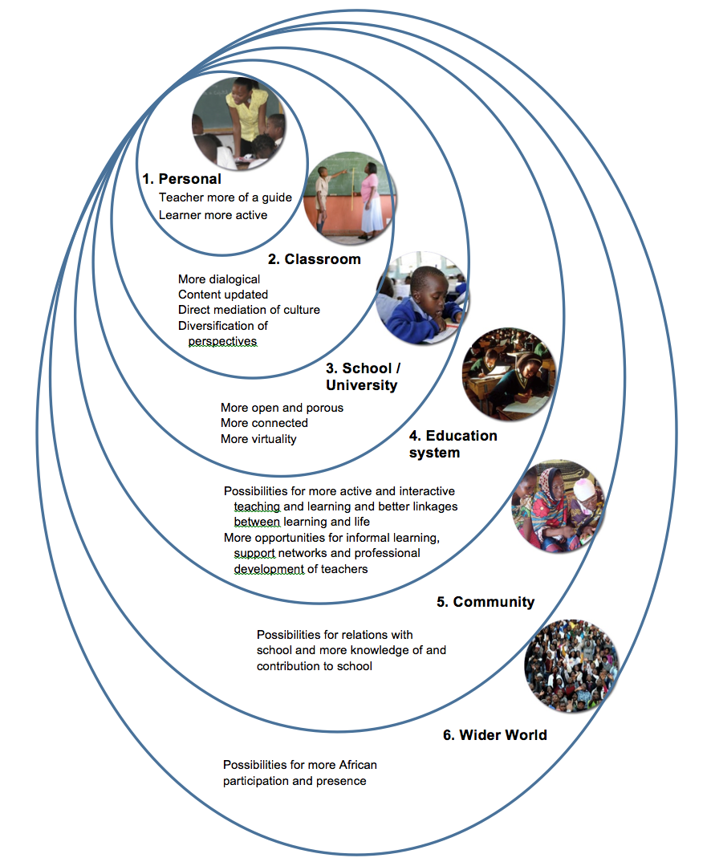
Notes:
1.
Changes at the personal level of teachers and students
With the pedagogical appropriation of ICT
teachers become more of a guide for learners and are
less inclined to have to be mere possessors and transmitters of knowledge,
a change described by Obanya (2012a) and
and which occurs when teachers shift toward socio-constructive pedagogical approaches.
Students seem to become more motivated,
confirming research findings by Karsenti (2003a, 2003b),
and engaged in their learning and the construction of their identities.
“Identity (or one’s sense of one’s place in the world and connection to others)
has profound implications for the ways in which one engages in learning settings” (Nasir, 2009, p. 2).
2. and 3.
Changes in classrooms and in schools
Whether teachers had anticipated or intended it at the outset,
it seems classrooms became places where
more diverse perspectives were encouraged or allowed, or just seeped in,
and where there was more time for discussion.
The content of courses was diversified and updated – beyond what is available in textbooks.
Schools became more porous – as staff
developed websites to share information;
created computer laboratories; and
sent groups of students into in nearby communities to converse with residents
and learn more about local culture, history and geography.
4.
Changes in the education system
Here a bit of extrapolation – beyond the original observations – is required.
If we think of the
“cumulative effect of participation”
in the cultural and social activities (Nasir, 2009, p. 3) of pedagogically appropriating ICT –
in which students become more involved in dialogue with their peers and teachers,
course content evolves, and schools become more open and in interaction with their environment –
we could imagine the education system becoming more linked to everyday life.
We could also imagine more informal opportunities for teacher networking and development.
These possible effects of the use of ICT
on the education system, in Mali,
have yet to be confirmed,
as the changes described by the 29 educators and two administrators interviewed
were in a nascent phase.
5.
Communities in which schools are located
Through the exploration of beyond-the-classroom conversations
about the use of ICT in education (objective 2),
it became evident how parents and elders had their word to say.
Teachers exerted their individual agency (van Binsbergen, 2004)
in appropriating ICT
and also considered the opinions and perspectives of others.
[Deciding what to graft into existing pedagogical and school culture
– the cultural initiative described by Fonlon (2012) –
seems to be a collective effort.]
Cultural renewal involved
confrontational and convivial communication
and collaboration
between schools and communities
including interaction
in which local knowledge and ways of knowing could be revalorized,
[as deemed necessary by Ela (2006) and Hountondji (2002),]
and find their way
into schools that had sought to stamp out African traditions and Africaness
[(Fonlon, 2010; Moumouni, 1964/1998; Nyamnjoh, 2004; Pence & Nsamenang, 2008)].
Though ICT alone will not make communities more welcoming of schools
and schools more in fruitful interaction with host communities,
the appropriation of ICT use as described by the teachers interviewed
seems to play a role in opening up these relations, for interrogation and renegotiation.
6.
The wider world
It was in relation to trying to understand
why professors pedagogically appropriate ICT (objective 3)
that the wider world – beyond West Africa – was most evoked.
Almost all six professors interviewed discussed their desires
to use ICT to facilitate and enhance African participation,
in global debates and scholarly production,
and transform how Africa and Africans are perceived and projected.
Future research is required to confirm
how the desired technologically mediated changes are actually taking place (or not).
WRAPPING UP
Evidence of changes at multiple levels
is not surprising
to the extent that theories of appropriation
refer to the transformative nature of appropriation processes,
as newness is integrated into individual and societal practices.
Artifacts, such as computers and internet,
and social others -- “as carriers of culture” --
become, according to Nasir (2009, p. 2),
“points of interchange
between cultural processes and individual learning,
and developmental processes.”
Educators, as they resist, envision, act, create, dialogue and synthesize
across multiple borders in their pedagogical appropriation of ICT,
work as agents of change (Andersson, 2006) in multiple milieus.
Had we considered changes only the personal level – of teachers and students –
or stopped our reflection at the level of classrooms and schools and universities,
we would have missed out
on how the pedagogical appropriation of ICT is
embedded in and likely shapes and is shaped as well
by the educational systems and communities in which schools are located,
not to mention the wider world.
“Development occurs simultaneously on multiple planes of experience […]
All of these planes of change influence all the others planes” (Nasir, 2009, p. 2).
[The suggested changes deserve to be studied over time,
via more interviews with teachers and learners and via classroom and school observation,
because, with the integration of ICT into education,
the nature of change “to all components of the system – including people – is unpredictable”
and takes time to become apparent (Kirkup & Kirkwood, 2005, in last paragraph of the discussion, p. 10 of the final handover version).]

Slide 31
Strengths and
Contributions of the Research
Insights into processes of harnessing ICT
Literature from sociology and cultural psychology
African scholars
Epistemological dilemmas
Mobilization of the concept of appropriation
Qualitative research methodology
Perspectives of teachers
Holistic approach to formal education
Upsetting of stereotypes
Notes:
Strengths and Contributions of the Research
We provided insights into the process of harnessing ICT
to pedagogical and other goals in West Africa.
2. We linked the findings with literature
from sociology
(Do-Nascimento, 2005; Jouët, 2000; Nyamnjoh, Durham, & Fokwang, 2002; Nyamnjoh & Shoro, 2011; Surman & Reilly, 2003).
and cultural psychology
(Vygotsky (1978), Bruner (1969) and Obanya (2011, 2012a, 2012b, 2014).
3. The work was rich in inspiration from African scholars.
4. We evoked epistemological dilemmas,
such as the relevance of education and very reasons
for the integration of ICT in education.
[When some researchers focus only on practical dilemmas
such as high teacher-student ratios and lack of teaching and learning materials].
5. We were able to meaningfully mobilize the concept of appropriation
in educational contexts in West Africa.
6. The qualitative research methodology
(Bernard, 2006; Karsenti & Savoie-Zajc, 2011; Thomas, 2013; Wertz et al., 2011)
allowed research participants
to explain their actions and beliefs in their own words (Haddon, 2000).
7. The perspectives of teachers,
which are often neglected or discounted,
were brought to the fore,
revealing some of the questions and challenges with which they grapple
in coming to terms with informational and technological revolution.
8. Through a holistic approach to formal education,
we showed that educators,
whether working in primary and high schools or at the university level,
are acting on desires to use ICT in transformative ways.
9. Finally, we upset stereotypes
of culture as stagnant or frozen, and
of Africans as recipients rather than shapers of identities and futures.

Slide 32
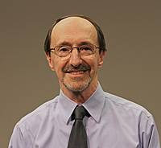
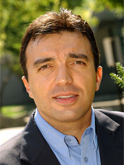
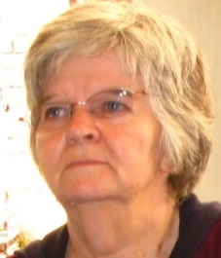
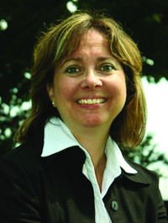

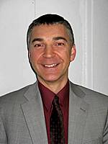
Grand merci aux membres du jury
Michel Lepage, président-rapporteur
Thierry Karsenti, directeur de recherche
Colette Gervais, co-directrice de recherche
Diane Biron, examinatrice externe
Vassilis Komis, Université de Patras, Grèce
François Bowen, représentant de la doyenne
Notes:
I would like to sincerely thank each of member of the jury,
for reading my thesis,
and for being here this morning, in person or virtually,
for this thesis defense.

Slide 33
Acknowledgements / Remerciements
Nia Kadidia Diallo ● Daouda Cissé ● Dramane Darave ● Kafui Dansou ● Denis Dougnon ● Moussa Diarra ● Moussa Dramé ● Gabriel Dumouchel ● Gabriel Yandjou ● Normand Roy ● Aurélien Fievez ● Sophie Goyer ● Pier-Philippe Chevigny ● Deborah Glassman ● Joan Sarno ● Suzan Hampton ● Jean-Michel and Gisèle Labatut ● Rohinton Medhora ● Angela Arnott ● Francois-Joseph Azoh ● Connie Freeman ● Nafissatou Diallo ● Nicole Genereux ● Yaro Yacouba ● Amitav Rath ● Dudley Andrew ● Catherine Daffé ● Carole Joubert ● Mohamed Maïga ● Francis Nyamnjoh ● Nadine Sanoh ● Maria Diallo ● Debbie Fredo ● Bréhima Tounkara ● Augustin Niango ● Aya and Patrick and Soutcho Touré ● Pénangnini Touré ● Frédérique Weyer ● Michel Carton ● Johnson Country Community College and Woodneath Library Center librarians ● IDRC colleagues ● Educational Research Network for West and Central Africa (ERNWACA) members and staff ● Pierre Fonkoua ● Therese Tchombe ● Hamidou Naparé ● Cheick Oumar Fomba ● Mireille Massouka ● Mamadou Lamine Diarra ● Adwoa Agyeman ● Natalia Kanem ● Renée Osté-Coulibaly ● Inga Schwarzkopf ● Jael Silliman ● Koura Diallo ● Mamadou Kani Konaté ● Pai Obanya ● Mamadou Ndoye ● Mary and Jerome Tajchman ● other PhD students in my cohort ● Professors Michel Lepage and Colette Gervais and Thierry Karsenti

